Slide 1
Engineering a Good Project
Drew Seaman

Slide 2
Engineering:
the work of designing and creating large structures (such as roads and bridges) or new products or systems by using scientific methods
the application of science and mathematics by which the properties of matter and the sources of energy in nature are made useful to people

Slide 3
Engineer:
EJCDEC – C-700:
The individual or entity named as such in the Agreement

Slide 4
Marketing
What are you Selling
Proposals
Responses to RFQ
Webpage
Facebook

Slide 5
Project
Define your goals
Prepare Outline
Refine approach to project requirements
What do you do if you don’t have needed skill set

Slide 6
Contract:
Owner
Who can sign?
Who has responsibility
Time for Design
Time for Construction
Cost/Quality Responsibilities
Communication

Slide 7
Contract:
Consultants
Delegation of Responsibility
Limitation of Liability?
Ability to perform
Change in personnel
Design – timeliness
Review – timeliness
Communication

Slide 8
Personnel Staffing:
Client Contact
Design
Construction Documents
Quality Control
Construction Observation
Chain of Command

Slide 9
Design:
Nothing is a Cookie Cutter
Chart your course and follow it
Avoid Construction Creep
Follow Project Outline
Quality Control

Slide 10
Design:
MEP
Coordinate drawings
Avoid Value Engineering
Structural
Soils, wind, snow, & water
Steel – connections
Wood Truss

Slide 11
General and Special Conditions:
Who prepares them?
Coordination with drawings
Separate Seminar
Unforeseen Conditions
Shop Drawings & Submittals
Schedules
Changes
Claims

Slide 12
Specifications:
What is Purpose?
Consistency
Master Spec –
What does it require?
Consistent with Product Specified
Impact on other Sections

Slide 13
Contractor:
Lowest Qualified Bidder
What is Qualified Bidder?
Review of Bids
Recommendation to Owner

Slide 14
Construction:
Know Contracts and Construction Documents
Schedules
RFIs
Submittals
Changes
Pay Requests

Slide 15
Completion:
Certificate of Substantial Completion
Notice of Acceptability
Final Completion
Project Close-out
Certifications

Slide 16
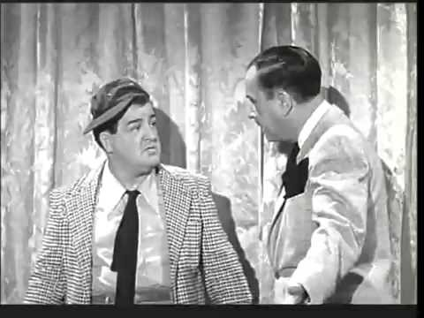
Communication:
Document Communications
Be Clear and Concise
Remember Who’s On First

