Slide 1
Health, Safety & Wellness and The Design Professional
Kathryn Breard Platt
Risk Manager and Claims Consultant, Architects and Engineers E&O
April 18, 2024
© 2024 by The Hartford. Classification: Company Confidential. No part of this document may be reproduced, published or used without the permission of The Hartford.

Slide 2
Agenda
Contract Language
Design Phase Services
Construction Phase Services
Claim Examples
© 2024 by The Hartford. Classification: Company Confidential. No part of this document may be reproduced, published or used without the permission of The Hartford.

Slide 3
Phase 1 – The Contract
© 2024 by The Hartford. Classification: Company Confidential. No part of this document may be reproduced, published or used without the permission of The Hartford.

Slide 4
Contract Language
Scope of work should specifically exclude control over site safety and construction means and methods.
Claim examples:
Scaffolding accident and resultant lawsuit against the architect and others
Worker fell in a hole on the project site and filed a lawsuit against the structural engineer and others
Worker injured by piece of falling concrete from the ceiling and sued MEP engineer and others
Clearly define your scope of work.
Claim examples:
Trip and fall on curb and resultant lawsuit against civil engineer and others
Motorcycle accident and lawsuit against traffic engineer and others
Multiple park injuries from one revitalization project
No unintended or intended third party beneficiaries.
Request a copy of the contractor’s contract as well.
© 2024 by The Hartford. Classification: Company Confidential. No part of this document may be reproduced, published or used without the permission of The Hartford.

Slide 5
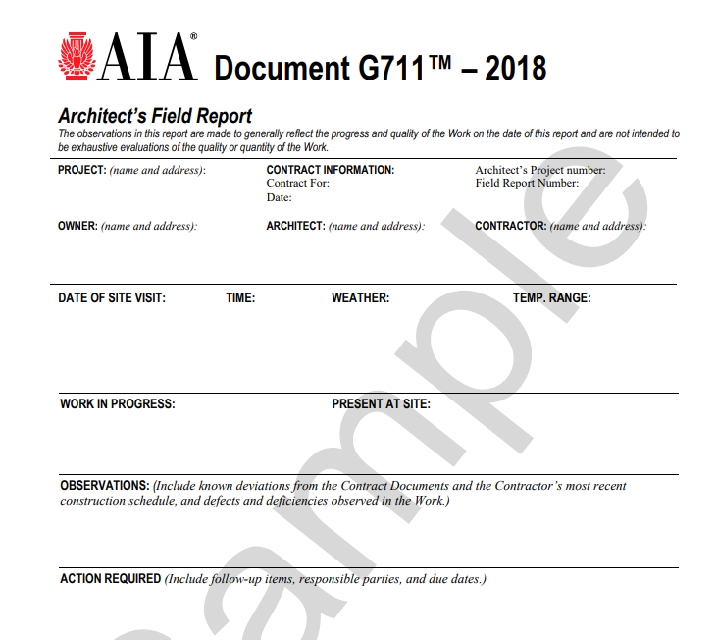
Contract Language – Specific is Terrific!
Site Visits:
Frequency
Objective
Report format
© 2024 by The Hartford. Classification: Company Confidential. No part of this document may be reproduced, published or used without the permission of The Hartford.

Slide 6
Contract Language – the Good, the Bad and the Ugly
What is good and bad about the below clause?
Example 1:
On the basis of on-site observations, the Architect shall keep the Owner informed of the progress and quality of the Work and shall immediately notify the Owner of any defects and deficiencies in the Work discovered by the Architect. The Architect and the Architect’s Subconsultants shall visit the Project at intervals appropriate to the stage of construction, at other times as reasonably requested by the Owner, and as otherwise agreed upon by the Owner and the Architect.
© 2024 by The Hartford. Classification: Company Confidential. No part of this document may be reproduced, published or used without the permission of The Hartford.

Slide 7
Contract Language – the Good, the Bad and the Ugly
What is good and bad about the below clause?
Example 2:
Although the Architect shall not be required to make exhaustive or continuous on-site inspections to check the quality or quantity of the Work, the Architect shall periodically inspect the quality and quantity of the Work as part of the Architect’s Basic Services and shall issue written reports of such inspections.
© 2024 by The Hartford. Classification: Company Confidential. No part of this document may be reproduced, published or used without the permission of The Hartford.

Slide 8
Contract Language – the Good, the Bad and the Ugly
What is good and bad about the below clause?
Example 3:
In the sole discretion of the Owner, the Owner may require the Architect and the Architect’s Subconsultants to come to the site where the Work may be disrupted or delayed by what appears to be insufficiency in design details or a failure to coordinate the design effort. The cost to the Architect (and its Subconsultants) is part of Basic Services and shall not be considered Additional Services. The Architect has no authority to make changes to approved plans and specifications, and shall not do so without the Owner’s written approval.
© 2024 by The Hartford. Classification: Company Confidential. No part of this document may be reproduced, published or used without the permission of The Hartford.

Slide 9
AIA Language
The Architect shall visit the site at intervals appropriate to the stage of construction, or as otherwise provided for in the contract, to become generally familiar with the progress and quality of the portion of the Work completed, and to determine, in general, if the Work observed is being performed in a manner indicating that the Work, when fully completed, will be in accordance with the Contract Documents. However, the Architect shall not be required to make exhaustive or continuous on-site inspections to check the quality or quantity of the Work. On the basis of the site visits, the Architect shall keep the Owner reasonably informed about the progress and quality of the portion of the Work completed, and promptly report to the Owner (I) known deviations from the Contract Documents, (2) known deviations from the most recent construction schedule submitted by the Contractor, and (3) defects and deficiencies observed in the Work.
© 2024 by The Hartford. Classification: Company Confidential. No part of this document may be reproduced, published or used without the permission of The Hartford.

Slide 10
AIA Language
The Architect has the authority to reject Work that does not conform to the Contract Documents. Whenever the Architect considers it necessary or advisable, the Architect shall have the authority to require inspection or testing of the Work in accordance with the provisions of the Contract Documents, whether or not the Work is fabricated, installed or completed. However, neither this authority of the Architect nor a decision made in good faith either to exercise or not to exercise such authority shall give rise to a duty or responsibility of the Architect to the Contractor, Subcontractors, suppliers, their agents or employees, or other persons or entities performing portions of the Work.
© 2024 by The Hartford. Classification: Company Confidential. No part of this document may be reproduced, published or used without the permission of The Hartford.

Slide 11
Phase 2 – Design Phase
© 2024 by The Hartford. Classification: Company Confidential. No part of this document may be reproduced, published or used without the permission of The Hartford.

Slide 12
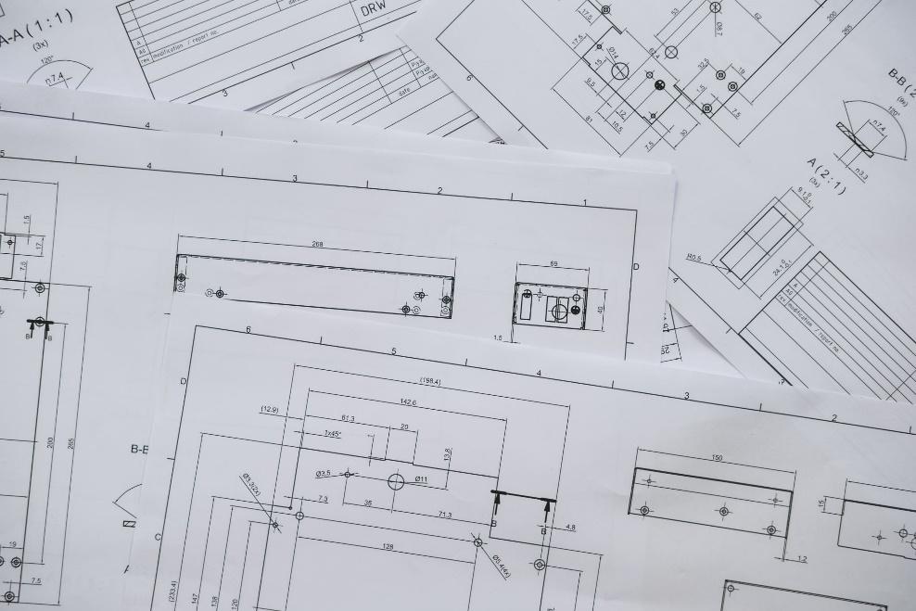
Design Phase
Documentation of Review
Plans and Specifications
Design professionals should consider construction safety issues during the construction and maintenance of the facility and address them in the design phase of the project. By anticipating hazards and applying their design skills to eliminate them, unsafe conditions can be reduced.
If owner-directed changes are not aligned with this, make sure you save evidence of the correspondence. Confirm verbal conversations in email and add those emails to the project file.
© 2024 by The Hartford. Classification: Company Confidential. No part of this document may be reproduced, published or used without the permission of The Hartford.

Slide 13
Phase 3 – Construction Administration
© 2024 by The Hartford. Classification: Company Confidential. No part of this document may be reproduced, published or used without the permission of The Hartford.

Slide 14
Construction Phase
Attending Site Visits:
What is required by the contract?
Site Visits should be well documented with notes saved to the file.
These notes are critical in your defense in the event of a claim for bodily injury.
Showing what you knew and what the conditions were on the day of the visit could be a key component to your defense.
What should you do if you witness an unsafe condition on the work site?
© 2024 by The Hartford. Classification: Company Confidential. No part of this document may be reproduced, published or used without the permission of The Hartford.

Slide 15
Case Law Regarding Duty – Kansas (actual knowledge or duty assumed by contract or conduct)
The Kansas Supreme Court in Balagna v. Shawnee County, Kansas et al., 668 P.2d 157 (Kan 1983), concluded the design professional is obligated to take some affirmative steps to protect the worker if dangerous condition is observed, i.e., actual knowledge of the danger.
In a case of first impression where there is no actual knowledge, the Kansas Supreme Court in Hanna v. Huer, Johns, Neel, Rivers & Webb, 662 P.2d 243 (Kan. 1983), found an architect who has agreed to supervise the project must specifically agree to supervise safety. The court listed seven factors to use in determining whether supervisory powers go beyond the contract: (1) actual supervision and control of the work; (2) retention of the right to supervise and control; (3) constant participation in ongoing activities at the construction site; (4) supervision and coordination of subcontractors; (5) assumption of responsibilities for safety practices; (6) authority to issue change orders; (7) the right to stop the work.
Thus, when the design professional does not assume by contract or conduct a duty for site safety, it is not liable for such injury unless it has actual knowledge of the danger.
© 2024 by The Hartford. Classification: Company Confidential. No part of this document may be reproduced, published or used without the permission of The Hartford.

Slide 16
Case Law Regarding Duty – Cases cited in Hanna, 662 P.2d 243 (Kan. 1983) – Montana, D.C., Maryland, and Arkansas
Cases which have found liability on the part of the design professional have usually focused upon specific facts creating a duty to the jobsite workmen.
Montana: Associated Engineers, Inc. v. Job, et. al., 370 F.2d 633 (8th Cir.1966). Owner hired engineer to design the project and supervise construction. The contract detailed supervisory duties, including safety, such that the provisions imposed upon the engineer an obligation to do more than assure conformity to specifications.
District of Columbia: Caldwell v. Bechtel, Inc., 631 F.2d 989 (D.C. Cir.1980). Defendant was a safety engineering firm with actual knowledge of the danger.
Maryland: Cutlip v. Lucky Stores, 325 A.2d 432 (Md. App.1974). The supervisory authority given the architect under his contract when coupled with his inspection and notice commitments to the County were sufficient to allow him to perceive the danger implicit in neglectful construction.
Arkansas: Erhart v. Hummonds, 334 S.W.2d 869 (Ark. 1960). The architect was paid additional fee for detailed supervision, and thus, it was a question for the jury as to whether the architect was negligent in failing to stop all work until shoring could be made safe.
© 2024 by The Hartford. Classification: Company Confidential. No part of this document may be reproduced, published or used without the permission of The Hartford.

Slide 17
Case Law Regarding Duty – Cases cited in Hanna, 662 P.2d 243 (Kan. 1983) (Cont.) – Michigan and Illinois
Estate of Clark v. Beard, 190 N.W.2d 373 (Mich. App. 1971), rev'd on other grounds, 388 Mich. 637 (Mich. 1972). The architect “was contractually bound to be the owner's representative, to inspect with authority to stop the work, and to use his powers under the building contract to enforce faithful performance.” The project engineer testified that, at least six days before the cave-in, he personally showed architect’s employee the west wall of the excavation was neither shored nor sloped and was cracking because of wet clay. Architect’s employee agreed the condition was dangerous and would have it corrected. Engineer testified the architect - and only the architect - had authority to shut down the job to correct the condition. He failed to do so.
Held: The dangerous condition was brought to the attention of the architect who had authority to stop the work and make the necessary correction. There was evidence from which the jury could find the architect had actual knowledge of the dangerous condition and sufficient time and authority to correct the condition, and the jury could conclude that failure to act constituted actionable negligence and was a proximate cause of the resulting death.
The Hanna factors were taken from Hausam v. Victor Gruen & Associates, 408 N.E.2d 1051 (Ill. App. Ct. 1980). In Hausam, the Appellate Court of Illinois noted, “One of the important considerations in cases involving architects is the extent of the architect's authority to ‘stop work’ under the contract.” However, “the right to reject work which fails to conform to the contract cannot be interpreted as the right to stop work when hazardous conditions or methods of construction existed.”
Block v. Lohan Assocs., Inc., 645 N.E.2d 207 (Ill. Ct. App. 1993), found that architect whose duties were to furnish plans, specifications, and calculations and to review and approve work for conformity to the architectural and engineering design intent had no duties regarding worker safety as he was not in charge of the work.
© 2024 by The Hartford. Classification: Company Confidential. No part of this document may be reproduced, published or used without the permission of The Hartford.

Slide 18
Case Law Regarding Duty – Case citing in Hanna, 662 P.2d 243 (Kan. 1983) (Cont.) – Mississippi
The Mississippi Supreme Court in Jones v. James Reeves Contractors, Inc., 701 So.2d 774 (Miss.1997), found there is no common law duty to warn of dangerous site conditions even if the architect has prior knowledge of the dangerous condition. The Court examined the seven-factor test devised in Hanna to determine whether the architect assumed a duty by conduct and found the architect did not assume a duty by conduct.
Hobson v. Waggoner Engineering Inc ., 878 So.2d 68 (Miss. Ct. App. 2003), extended the Jones ruling to engineers. Thus, “[u]nless the [design professional] has undertaken by conduct or contract to supervise a construction project, he is under no duty to notify or warn workers or employees of the contractor or subcontractor of hazardous conditions on the construction site.”
The two cases relied heavily on Midwest cases.
© 2024 by The Hartford. Classification: Company Confidential. No part of this document may be reproduced, published or used without the permission of The Hartford.

Slide 19
Case Law Regarding Duty – Pennsylvania and Ohio
The Superior Court of Pennsylvania in Herczeg v. Hampton Township Municipal Authority, 766 A2d 866 (Pa. 2001), concluded that the design professional is not obligated to take some affirmative steps to protect the worker. In other words, knowledge by itself does not create a tort duty.
Marshall v. Port Authority of Allegheny County, 568 A.2d 931 (Pa. Super. Ct. 1990), held an engineer who contracted to monitor the construction to assure the delivery of the specified systems in accordance with the contract drawings and specs did not have a duty with respect to jobsite safety hazards.
The Court of Appeals for the Tenth Circuit of Ohio in Nicholson v. Turner/Cargile, et. al., 107 Ohio App. 3d 797 (Ohio Ct. App. 1995), held that “if design professionals have actual knowledge of a hazard, they then have a duty to stop or prevent the dangerous condition or practice. If design professionals, however, do not have actual knowledge, their tort duties arise if they actively participate in the construction or explicitly assume responsibility for worker safety.” This is the “active participation doctrine,” which is highly factual, i.e., instruct, interfere, restrict, or control in the context of the injury happening.
© 2024 by The Hartford. Classification: Company Confidential. No part of this document may be reproduced, published or used without the permission of The Hartford.

Slide 20
Case Law Regarding Duty – Iowa and Colorado
The Supreme Court of Iowa in Shepherd Components, Inc. v. Brice Petrides-Donohue & Associates, Inc., 473 N.W.2d 612 (Iowa 1991), discussed an engineer’s duty to protect third parties from harm. The Court recognized a design professional’s potential for liability extends beyond privity of contract. However, “an engineer does not, by reason of its duty to inspect the construction site, assume responsibility for either the day-to-day construction methods utilized by the contractor or the contractor's negligence.” Additionally, “Even if [the engineer] had authority to stop work that did not conform with the contract, he did not have contractual authority to stop unsafe construction methods which were under the sole control of [the contractor].” Thus, the Court limited the engineer’s duties to the four corners of the agreement.
Wheeler & Lewis v. Slifer, 577 P.2d 1092 (Col. 1978), held an architect who agreed to make periodic visits to familiarize himself with the progress and determine in general if the work was proceeding in accordance with the construction documents had no duty to supervise the construction precautions taken for the safety of the workmen.
© 2024 by The Hartford. Classification: Company Confidential. No part of this document may be reproduced, published or used without the permission of The Hartford.

Slide 21
But What About Ethics?
AIA Code of Professional Conduct
ASCE Code of Ethics
National Society of Professional Engineers
Not meant to define the standard of care.
Not intended to be used in a civil action as evidence of the standard of care. Indeed, courts have held that expert opinions that rely on ethics do not support breach of duty in a civil context. Hamon Contractors, Inc. v. Carter & Burgess, Inc., 229 P.3d 282 (Colo. App. 2009); Michael v. Huffman Oil Co., 661 SE.2d 1 (2008); John C. Nelson Constr., LLC v. Britt, Peters & Assocs., 2020 U.S. Dist. LEXIS 73444 (S.D. Miss. Apr. 27, 2020)
However, see NSPE BER Case No. 12-11. Engineer employed by contractor to design construction scaffolding is concerned CMVs passing by pose a safety hazard. Board found the engineer should immediately notify verbally (and in writing if necessary) his immediate supervisor at the construction company of the safety hazards to employees (and others) due to commercial vehicles passing by while inspection and repair is being performed on the ramps.
© 2024 by The Hartford. Classification: Company Confidential. No part of this document may be reproduced, published or used without the permission of The Hartford.
Notes:
AIA 2020 Code of Ethics and Professional Conduct states, “The Code is not intended to suggest or define the standard of care an architect is required to meet in providing its professional services and should not be used in a civil action against an architect as evidence that the standard of care has been breached. Finally, architects should continue to consult with state laws or regulations governing the practice of architecture.
Note: Canon II (Obligations to the Public) Commentary states, “This rule extends only to violations of the building laws that threaten the public safety. The obligation under this rule applies only to the safety of the finished project, an obligation coextensive with the usual undertaking of an architect.”
ASCE 2020 Code of Ethics, footnote 1 states, “This Code does not establish a standard of care, nor should it be interpreted as such.”

Slide 22
What is the Best Practice?
Legal liability will be governed by the law appliable to the project.
Obligations and responsibilities for site safety should be expressly addressed in clear and unambiguous terms in the design professional’s contract, and the design professional should not deviate from those terms.
Consider what jury members will think if they hear you knew of the danger but said nothing!
If you notice unsafe conditions on site:
Alert those in immediate danger
Remove your staff from potentially harmful conditions
Verbally notify the person responsible for safety onsite
Provide immediate notification in writing to the owner and contractor of your observation with qualification that you are not undertaking a duty for site safety by providing the notice.
© 2024 by The Hartford. Classification: Company Confidential. No part of this document may be reproduced, published or used without the permission of The Hartford.

Slide 23
Construction Phase
What should you do in the event of an injury?
Notify your insurance agent / carrier
Do not accept responsibility or admit fault
Collect project documentation
Advise employees to preserve all project documents and correspondence
© 2024 by The Hartford. Classification: Company Confidential. No part of this document may be reproduced, published or used without the permission of The Hartford.

Slide 24
Claim Studies
© 2024 by The Hartford. Classification: Company Confidential. No part of this document may be reproduced, published or used without the permission of The Hartford.

Slide 25
Top Loss Event Trends
Slip and fall at restaurants
Accidents at residential projects
Jobsite accidents during construction
Highway accidents
Slip and fall at medical care facilities
© 2024 by The Hartford. Classification: Company Confidential. No part of this document may be reproduced, published or used without the permission of The Hartford.

Slide 26
Architects and Third-Party Injury Claims
Example 1: In 2017, Architect contracted with the County to provide architectural services for a new, 2-story medical center. In April 2021, a worker slipped and fell on a curb and filed suit against the owner, architect, and others for a hazardous condition. Upon showing the Architect had no duty for site safety, had no duty to design the subject area, was not on site at the time of the accident, and had no knowledge of an alleged hazardous condition, the Architect was voluntarily dismissed.
Example 2: In 2018, Architect contracted with the City to provide architectural services for the renovation of a Senior Center. In July 2020, a worker fell from a ladder and was injured. Upon showing the Architect had no duty for site safety, was not on site at the time of the accident, and had no knowledge of an alleged hazardous condition, the Architect was voluntarily dismissed.
© 2024 by The Hartford. Classification: Company Confidential. No part of this document may be reproduced, published or used without the permission of The Hartford.

Slide 27
Engineers and Third-Party Injury Claims
Example 1: Engineer contracted with the City to provide civil engineering services for new streetscapes with a variety of sidewalk and roadway features. In June 2020, Plaintiff tripped and fell on a curb outside of a restaurant and sued the Contractor and others. After plaintiff received documents from the Engineer pursuant to a subpoena, plaintiff amended his Complaint to join the Engineer to the lawsuit. Certificate of Merit claimed the “as-built” boardwalk/wood decking condition at the back of the curb did not meet applicable building codes, reasonable practices, and/or standards of the day. However, no evidence of a deviation from the standard of care in the Engineer’s plans or specifications resulted in summary judgment.
Example 2: Engineer contracted with the City to provide inspection and plan review services for a new development, including a movie theater. In June 2019, Plaintiff fell between the floor and back of theater seats. Plaintiff alleged the Engineer was negligent in the performance of its duties to “design, engineer, construct, and inspect the renovations in a matter such that the Premises was reasonably safe and free of unreasonable hazards for invitees.” Detailed files demonstrated Engineer did not perform any services in the subject theater. Engineer was dismissed on summary judgment.
© 2024 by The Hartford. Classification: Company Confidential. No part of this document may be reproduced, published or used without the permission of The Hartford.

Slide 28
Engineers and Third-Party Injury Claims (Cont.)
Example 3: MEP engineer was subconsultant to AOR and provided services related to the upgrade of a sprinkler and HVAC systems for a large department store. Plaintiff alleged that, in June 2019, he was injured while performing construction work, and more specifically, that a piece of concrete fell from the ceiling onto his head. The MEP engineer had no role in the in the direction, supervision or control of concrete work, did not perform any construction services, and was not present, nor required to be present, on the date of the incident. With good record keeping, defense counsel secured a voluntary dismissal of the MEP engineer.
Example 4: In 2018, Civil engineer contracted with the County to provide services related to the renovation of a large public park. Phase II included upgrading racing slides, adding a playground, and developing golf, tennis, and hockey play areas. Although the “upgrading racing slides” in practice concerned the civil design surrounding the slides that were designed and provided by others, the agreement was not specific. Multiple slide injuries and lawsuits followed.
© 2024 by The Hartford. Classification: Company Confidential. No part of this document may be reproduced, published or used without the permission of The Hartford.

Slide 29
Design Professionals and the ADA/FHA
ADA/FHA Violations
Title VIII of the Civil Rights Act of 1968, as amended by the Fair Housing Amendments Act of 1988 (“FHA”), 42 U.S.C. §§ 3601-3619
The design and construction of covered multifamily dwellings (4+ units) must be such that “the public use and common use portions of such dwellings are readily accessible to and usable by handicapped persons.” This includes wide enough doorways, accessible routes, light switches, thermostats, outlets, grab bars, useable kitchens and bathrooms.
“When a group of entities enters into the design and construction of a covered dwelling, all participants in the process as a whole are bound to follow the FHA. To hold otherwise would defeat the purpose of the FHA to create available housing for handicapped individuals and allow wrongful participants in the design and construction process to remain unaccountable. In essence, any entity who contributes to a violation of the FHA would be liable. By this, the Court does not suggest that all participants are jointly and severally liable for the wrongful actions of others regardless of their participation in the wrongdoing, but rather, that those who are wrongful participants are subject to liability for violating the FHA.” Baltimore Neighborhoods, Inc. v. Rommel Builders, Inc., 3 F. Supp. 2d 661, 665 (D. Md. 1998).
Title III of the Americans with Disabilities Act of 1990 (“ADA”), 42 U.S.C. § 12181-12189
“No individual shall be discriminated against on the basis of disability in the full and equal enjoyment of the goods, services, facilities, privileges, advantages, or accommodations of any place of public accommodation by any person who owns, leases (or leases to), or operates a place of public accommodation.”
© 2024 by The Hartford. Classification: Company Confidential. No part of this document may be reproduced, published or used without the permission of The Hartford.

Slide 30
Dispute Resolution Options
Mediation
Consider including a pre-suit mediation clause in your agreement
Mutual selection of a mediator (as opposed to the AAA) is generally quick and cheaper
Arbitration
We do not favor arbitration
Virtually zero chance of early dismissal
Just as costly, if not more costly, than litigation
No appeal
Litigation
Do not waive a jury trial in your agreement
Panel Case Evaluation
No longer required in Michigan, this procedure required tort cases be submitted to a panel consisting of three persons who, within 14 days of the hearing, would perform an evaluation, and the parties then had 28 days to accept or reject the evaluation.
If both parties accepted, the case settled, but if one party rejected, then they proceed to trial.
Penalty: The rejecting party must obtain a more favorable result at trial (usually at least 10%) or they must pay the other party’s attorney’s fees and costs from the time of the case evaluation rejection through trial.
© 2024 by The Hartford. Classification: Company Confidential. No part of this document may be reproduced, published or used without the permission of The Hartford.

Slide 31
Do you always report subpoenas to your professional liability carrier?
POLL
© 2024 by The Hartford. Classification: Company Confidential. No part of this document may be reproduced, published or used without the permission of The Hartford.

Slide 32
Not Always “Just A Subpoena”…
What is a subpoena?
A subpoena is a discovery device where litigants can obtain documents and/or testimony from non-litigants prior to trial or at trial via a trial subpoena.
A subpoena duces tecum is a subpoena for documents, and oftentimes, they are extremely broad in scope.
The rules applicable to subpoenas are similar across the states and in federal court.
Why is counsel important?
What can you do to lessen the likelihood of litigation?
© 2024 by The Hartford. Classification: Company Confidential. No part of this document may be reproduced, published or used without the permission of The Hartford.

Slide 33
Questions?
© 2024 by The Hartford. Classification: Company Confidential. No part of this document may be reproduced, published or used without the permission of The Hartford.

Slide 34
Conclusion
Plaintiffs will make broad sweeping allegations about your role and responsibilities. Be sure to define what your role is in clear and unambiguous terms. While we cannot prevent Plaintiffs from making these broad claims, having a clear contract will make it easier to defend your scope and your responsibilities.
When accidents happen, contact PUI and your carrier to discuss whether setting up a pre-claim file is warranted.
If you receive a subpoena, do not respond without help!
Always document your file.
© 2024 by The Hartford. Classification: Company Confidential. No part of this document may be reproduced, published or used without the permission of The Hartford.

Slide 35
Contact Information
If you have any questions regarding this presentation, you may reach out to the presenter.
Kathryn Platt
Kathryn.Platt@thehartford.com
© 2024 by The Hartford. Classification: Company Confidential. No part of this document may be reproduced, published or used without the permission of The Hartford.

Slide 36
The information provided in these materials is intended to be general and advisory in nature. It shall not be considered legal advice. The Hartford does not warrant that the implementation of any view or recommendation contained herein will: (i) result in the elimination of any unsafe conditions at your business locations or with respect to your business operations; or (ii) be an appropriate legal or business practice. The Hartford assumes no responsibility for the control or correction of hazards or legal compliance with respect to your business practices, and the views and recommendations contained herein shall not constitute our undertaking, on your behalf or for the benefit of others, to determine or warrant that your business premises, locations or operations are safe or healthful, or are in compliance with any law, rule or regulation. Readers seeking to resolve specific safety, legal or business issues or concerns related to the information provided in these materials should consult their safety consultant, attorney or business advisors. All information and representations contained herein are as of April 2024.
Certain coverages vary by state and may not be available to all businesses. All Hartford coverages and services described on this page may be offered by one or more of the property and casualty insurance company subsidiaries of The Hartford Financial Services Group, Inc. In Texas, Arizona, New Hampshire, Washington and California by Hartford Accident and Indemnity Company, Hartford Fire Insurance Company, Hartford Casualty Insurance Company, Hartford Lloyd’s Insurance Company, Hartford Insurance Company of the Midwest, Navigators Insurance Company, Navigators Specialty Insurance Company, Maxum Casualty Insurance Company, Maxum Indemnity Company, Trumbull Insurance Company, Twin City Fire Insurance Company, Hartford Underwriters Insurance Company, Property and Casualty Insurance Company of Hartford and Sentinel Insurance Company, Ltd. and its property and casualty insurance company affiliates, One Hartford Plaza, Hartford, CT 06155.
The Hartford Financial Services Group, Inc., (NYSE: HIG) operates through its subsidiaries, including the underwriting company Hartford Fire insurance Company, under the brand name, The Hartford®, and is headquartered in Hartford, CT. For additional details, please read The Hartford’s legal notice at www.thehartford.com.

