Slide 1
Don’t Let Construction Administration Services Become a Claims Maker
Architects and Engineers Professional Liability Workshop

Slide 2
DISCLAIMER
This program or presentation is only a tool to assist you in managing your responsibility to maintain safe premises, practices, operations and equipment, and is not for the benefit of any other party. The program or presentation does not cover all possible hazardous conditions or unsafe acts that may exist, and does not constitute legal advice. For decisions regarding use of the practices suggested by this program or presentation, follow the advice of your own legal counsel. Travelers disclaims all forms of warranties whatsoever, without limitation. Implementation of any practices suggested by this program or presentation is at your sole discretion, and Travelers or its affiliates shall not be liable to any party for any damages whatsoever arising out of, or in connection with, the information provided or its use. This material does not amend, or otherwise affect, the provisions or coverages of any insurance policy or bond issued by Travelers, nor is it a representation that coverage does or does not exist for any particular claim or loss under any such policy or bond. Coverage depends on the facts and circumstances involved in the claim or loss, all applicable policy or bond provisions, and any applicable law.

Slide 3
Construction Services Phase
Need for high level of risk awareness.
Phase where the “rubber hits the road.”
Most claims arise during the construction phase.
The designer has the least control and faces constantly changing conditions.

Slide 4
Pre-Construction Steps
Evaluate the project, owner and other parties.
Evaluate your firm’s resources and ability.
Negotiate fair and coordinated contract documents.
Manage the client’s expectations.
Establish your level of construction phase involvement.

Slide 5
The Purpose of the Site Visit
Determine the purpose of each visit.
Contract should specify frequency and timing of visits.
If you do not have to be there – do not go.
Send appropriate person to the site.

Slide 6
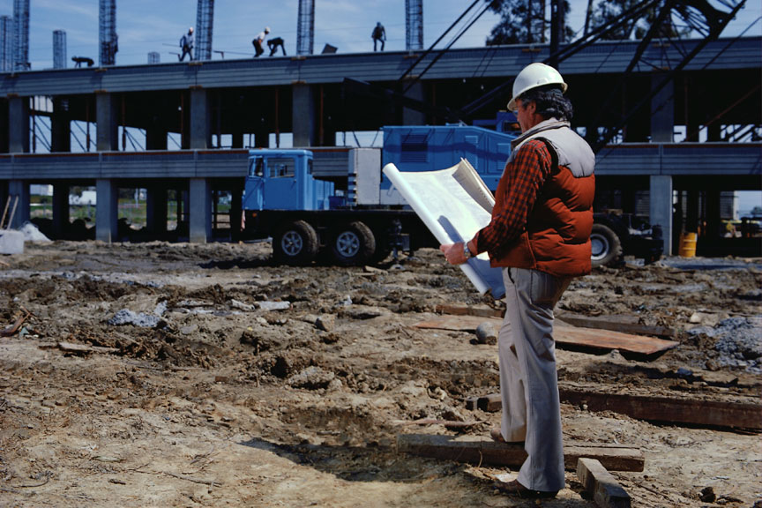
Observation, Not Inspection
Check that construction is proceeding in conformance in general with plans.
It is impossible to guarantee the contractor’s performance.
“Inspection, supervision and oversight” suggests unwanted control of construction.

Slide 7
Documentation of the Site Visit
Develop a “to do” checklist for each site visit.
Prepare a written report promptly after each visit.
Avoid editorial comments.
Record factual observations and conditions.
If it gets heated, stay focused and keep it professional.
Photographing the job site is a good idea.

Slide 8
Rejection of Work
Never stop the work.
Only the owner can ultimately accept work that differs from the contract documents.
Beware of advising on the means and methods of correcting defective work.

Slide 9
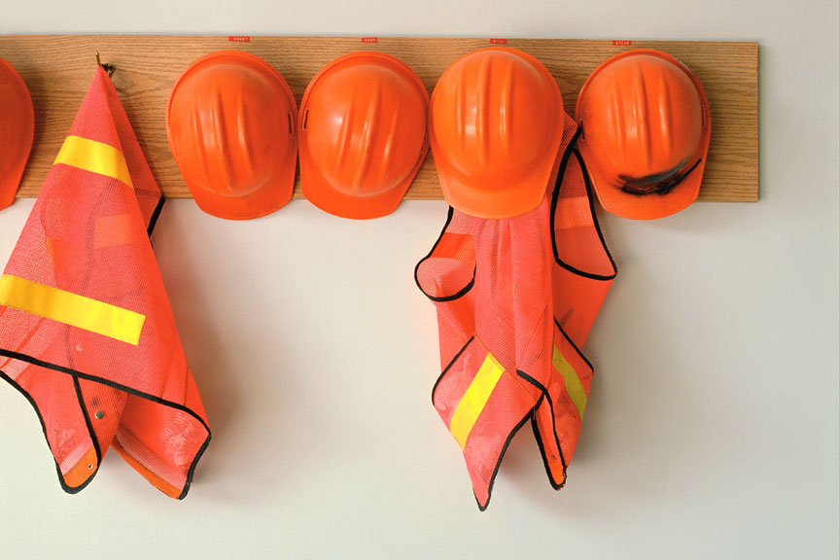
Site Safety — Who’s Responsible?
You have a duty to protect your own employees.
Your contract should clearly exclude responsibility for job site safety.
Do not venture beyond your contractual responsibilities because your actions can create liability where none existed.
Keep accurate, complete and timely records of site visits.

Slide 10
Site Safety — Identify the Risk
Know your state’s law on site safety liability.
Workers Compensation laws affect design liability.
CM and D/B change the rules with regard to site safety.
Consult with local, experienced legal counsel.

Slide 11
Site Safety
Steps to take if you see an obvious hazard:
Alert those in imminent danger.
Address the issue with the project foreman.
Remove your personnel from the hazardous area.
Do not stop the work.
Do not tell the contractor how to correct the situation.
Immediately notify the owner and contractor in writing of your observation.

Slide 12
Contractor Termination
Know when termination is justified and the actions to take.
Only the owner should have the authority to terminate.
Provide opinions based upon factual observations and unbiased professional judgment.

Slide 13
Voluntary Termination
Courts view termination as a drastic act.
Comply with all termination notice requirements.
You need to limit your ongoing liability.
Give the client a chance to correct contract violations.
Consult with your insurance representative and legal counsel.

Slide 14
Shop Drawings & Submittals
Present a good opportunity to prevent claims.
But … poor internal review process can lead to claims
Contract should stipulate a reasonable time for review.
Employ a “QA/QC” plan for the review of shop drawings.
Maintain a shop drawing review log.
Retain copies of all submittals.
Return shop drawings that were not required.
Send copies of correspondence to owner.
Consultant and prime process should be consistent.
Use a qualified person for final review.

Slide 15
Shop Drawings Procedures
Shop drawings that deviate from the contract documents should be noted. Request corrections.
Do not review shop drawings that exclude the contractor’s stamp of approval. Return to sender — “not reviewed.”
Sub-consultant’s stamp should agree with the Prime’s stamp.

Slide 16
With Change Comes Risk
Set expectation with clients up front.
Process needs to follow the contract precisely.
Communicate with all parties and carefully document the communication.
Carefully examine the impact of any proposed changes.
Execute quickly to prevent project delays.

Slide 17
Contractor Requests for Information
Excessive or repetitive RFIs may signal an increased risk both for the design professional and the owner.
Understand and enforce contract provisions for RFIs.
Excessive or repetitive RFIs should be addressed with the owner and contractor.
Like shop drawings, a consistent response process is critical.

Slide 18
Payment Certifications
Use good contract language: avoid guarantees and warranties.
Require contractor’s affidavit and/or AIA G702.
View the work before processing payment requests.
Do not get into means, methods or control issues.
Use roster of contractors and subs (their sworn statements).
Use schedule of values and require lien waivers.

Slide 19
Documentation
Consistent documentation increases your credibility.
Documentation includes written records, audio/video tapes, photographs and computer records.
Observations should be promptly recorded.
Record observed facts — avoid unneeded editorial comments.
Assume all project records are discoverable.
Record retention should at least track state statutes plus repose.

Slide 20
Records Preservation - Examples
Contracts and amendments.
Significant conversations.
Meeting notes.
Phone log.
Reports and correspondence.
Advisory letters.
Shop drawing and change order logs.
Invoices.
Client approvals.
Product information.
Site visit reports.
Correspondence with the contractor and client.
Project completion documentation.
Photographs and video
RFIs

Slide 21
Crisis Management
Maintain a calm, positive attitude.
Do not admit liability or take responsibility.
Establish a media policy with a firm contact.
Seek objective opinion from third party.
Notify your insurance representative immediately.

Slide 22
Questions?
This concludes our presentation. Please feel free to contact me with any additional questions.
Laura Guagliardo
Travelers
630-961-8167
lguaglia@Travelers.com

