Slide 1
April 6 & 7, 2022 Professional Underwriters, Inc. Seminar for Design Professionals

Slide 2
Design Professional’s Liability – Design Build Projects
Thomas F. Waggoner, Esq.
Straub, Seaman & Allen, P.C.

Slide 3
PROGRAM
Explain potential concerns related to insurance, incorporating the prime contract into the design professional’s contract, limitation of liability clauses, warranty language, standards of care, indemnity provisions.
Compare differing approaches through conflicting court decisions.
Analyze contract language to mitigate the design professional’s risk.

Slide 4
Why Is Design-Build Gaining Popularity?
Commencement of work can be fast-tracked
Better cost control
Single source responsibility
Green house objectives can be better achieved
Removal of restrictions for public and P3 projects
1 Brunner & O’Connor Construction Law § 2.17 Project delivery methods – Design-build and turnkey

Slide 5
Potential Liability Issues
Shifts, but does eliminate, litigation risks
Legal confusion
Spearin Doctrine
Standard of care
M.C.L.A. § 339.2008(3)
Contract confusion
Interplay
Meaning of terms (e.g. “Work”)
Insurance & Bonds

Slide 6
3 Sub-Types
Design services provided by in-house staff
Joint or Co-venture partners
Subcontracted Architects/Engineers

Slide 7
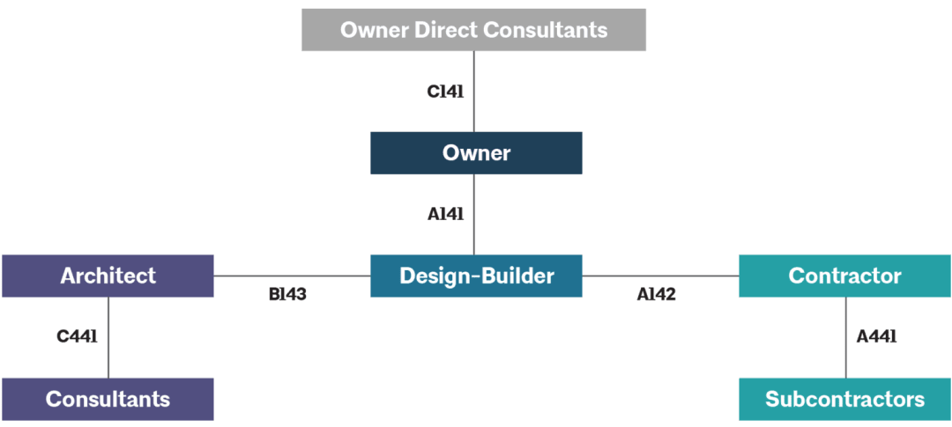
Contract Relationships
https://www.aiacontacts.org/contract-doc-ages/27146-design-build-family

Slide 8
Insurance Issues
1. Design-Build, D/B’s legal obligations for design may exceed A/E’s
2. D-B-B, A/E’s do not warrant their design
3. CGL and umbrella/excess policies exclude coverage for professional services
4. Contractor Errors & Omissions Insurance
5. Annual basis vs. project specific basis
6. Long-tail liabilities
7. Bonds –exclude coverage for professional services
8. Sub-consultants
unique insurance instruments

Slide 9
Insurance Program
“The Parties shall retain an insurance consultant to provide advice and assistance with respect to integrated insurance products such as Owner or Contractor-Controlled Insurance Programs or with respect to the individual insurance requirements for the Parties and other Project participants . . . . Any insurance program the Parties select shall be . . . Structured to provide adequate coverage at reasonable cost, striving to avoid duplication in coverage or exposure gaps.”
Section 7.1 of AIA C191-2009, Standard Form Multi Party Agreement for Integrated Project Delivery

Slide 10
Standard Form Contracts
AIA Family of Construction Documents
EJCDC Family of Construction Documents
Associated General Contractors of America (“AGC”) – Family of Construction Documents
ConsensusDocs – Family of Construction Documents

Slide 11
Standard Form Agreements
AIA, EJCDC, AGC & Consensus
Do not assume standard forms are o.k.
Need to be reviewed for each project
Tailor to project
Correlate changes to all sections of standard forms

Slide 12
Cases
Centex/Worthgroup, LLC v. Worthgroup Architects, L.P. (New Mexico 2015)
Schenkel & Shultz, Inc. v. Hermon F. Fox & Assoc., P.C. (North Carolina 2008)

Slide 13
Flow Down Clause - Centex
In respect of the design work, Architect shall, except as otherwise provided herein, have all rights toward Centex which Centex has under the Prime Contract towards the Owner and Architect shall, to the extent permitted by applicable laws and except as provided herein, assume all obligations, risks, and responsibilities toward Centex which Centex has assumed towards the Owner in the Prime Contract with respect to the design work.

Slide 14
Flow Down Clause - Schenkel
Consultant’s services shall be performed according to this Agreement with the Architect in the same manner and to the same extent that the Architect is bound by the attached Prime Agreement to perform such services for the Owner. Except as set forth herein, the Consultant shall not have any duties or responsibilities for any other part of the Project.”

Slide 15
Don’t Forget About Consultants
To the extent the provisions of the Prime Agreement apply to This Portion of the Project, the Architect shall assume toward the Consultant all obligations and responsibilities that the Design-Builder assumes toward the Architect, and the Consultant shall assume toward the Architect all obligations and responsibilities that the Architect assumes toward the Design-Builder. Insofar as applicable to this Agreement, the Architect shall have the benefit of all rights, remedies and redress against the Consultant that he Design-Builder, under the Prime Agreement, has against he Architect, and the Consultant shall have the benefit of all rights, remedies and redress against the Architect that the Architect, under the Prime Agreement, has against the Design-Builder. Where a provision of the Prime Agreement is inconsistent with a provision of this Agreement, this Agreement shall govern.
AIA Document C441-2014, Standard Form of Agreement Between Architect and Consultant for a Design-Build Project

Slide 16
Prime Contract - Limitation of Liability Clause
“In addition to all other insurance requirements set forth in this Agreement, Design/Builder shall require its design professional Subcontractor(s) to obtain and maintain professional errors and omissions coverage with respect to design services in accordance herewith . . .Such coverage shall be for each such design professional Subcontractor in an amount not less than $3,000,000. Owner agrees that it will limit Design/Builder liability to Owner for any errors and omissions in the design of the Project to whatever sums Owner is able to collect from the above described professional errors and omissions insurance carrier.”

Slide 17
Subcontract - Centex
The subcontract also provides a general clause, which makes Architect responsible for “redesign costs and additional construction costs of Centex and/or the contractor required to correct Architect’s errors or omissions.”

Slide 18
Rules of Construction
“The general rule of freedom of contract includes the freedom to make a bad bargain.” Ind. Bell Tel. Co. v. Mygrant (Ind. 1984)
Ambiguity
“Words of definite limitation”
Specific Language over General Language
Order of Precedence Clause

Slide 19
Risk Management - Redesign
“The Architect is responsible for redesign services and additional construction costs required to correct Architect’s errors or omissions, and will do so without additional compensation if due to Architect’s failure to perform services consistent with the Standard of Care. However, the total liability, in the aggregate, of Architect and its officers, directors, partners, employees, agents and subconsultants, to Client, and anyone claiming through or under Client, for any redesign services and additional construction costs shall not exceed the amount of insurance proceeds available up to the amounts of insurance required by this Agreement.”

Slide 20
Limitation of Liability Clause
Limitation of Liability Clause
Not to exceed total compensation received
Not to exceed the amount of insurance proceeds
Exculpatory Clause
Consequential Damages Clause

Slide 21
Typical Indemnification Clause
GENERAL INDEMNITY. To the fullest extent permitted by law, the Professional shall defend, protect, hold harmless, and indemnify the Owner and the Owner’s Related Parties from and against any and all liability, loss, claims, demands, suits, costs, fees and expenses (including actual fees and expenses of attorneys, expert witnesses, and other consultants), by whomsoever brought or alleged, and regardless of the legal theories upon which premised, including, but not limited to, those actually or allegedly arising out of bodily injury to, or sickness or death of, any person, or property damage or destruction (including loss of use), which may be imposed upon, incurred by or asserted against the Owner or the Owner’s Related Parties allegedly or actually arising out of or resulting from the Professional’s services, including without limitation any breach of contract or negligent act or omission (i) of the Professional; or (ii) of the Professional’s consultants, subcontractors or suppliers; or (iii) of the agents, employees or servants of the Professional or its consultants, subcontractors or suppliers.

Slide 22
Typical Indemnification Clause
“Engineer shall indemnify, exonerate, protect, defend (with counsel acceptable to the Design-Builder), hold harmless and reimburse Design-Builder from and against any and all damages (including without limitation, bodily injury, illness or death or property damage), losses, liabilities, obligations, penalties, claims (including without limitation, claims predicated upon theories of negligence, fault, breach of warranty, products, liability or strict liability), litigation, demands, defenses, judgments, suits, proceedings, costs, disbursements, or expenses of any kind or nature whatsoever, including without limitation, attorneys’ fees and experts’ fees, investigative and discovery costs and court costs, which may at any time be imposed upon, incurred by, asserted against, or awarded against Design-Builder which are in any way related to the Engineer’s performance under this Agreement but only to the extent arising from (i) any negligent act, omission or strict liability of Engineer, Engineer’s licensees, agents, servants or employees of any third party, (ii) any default by the Engineer under any of the terms or covenants of this Agreement, or (iii) any warranty given by or required to be given by Engineer relating to the performance of Engineer under this Agreement.”

Slide 23
Duty to Defend
“ . . the duty to defend, outside the context of an insurance contract but like an insurance contract, is not coextensive with the duty to indemnify. Rather, the duty to defend is broader than the duty to indemnify.”
MidAmerica Const. Mgt., Inc. v. MasTec North America, (10th Cir. 2006)

Slide 24
Risk Management – Duty to Defend
“Consultant shall indemnify and hold harmless (but not defend) the Client, its officers, directors, and employees (“Indemnitees”) from and against those damages and costs that Indemnitee incurs as a result of third party tort claims to the extent caused by the willful misconduct or negligent act, error or omissions of the Consultant or anyone for whom the Consultant is legally responsible, subject to any limitations of liability contained in this Agreement.”
Suggested Wording to Use When Revising and Redlining Design Professional Contracts for Risk Allocation and Insurability of Risks, by J. Kent Holland, Jr., in ConstructionRisk, LLC 2018

Slide 25
Risk Management Indemnification – third party claims only
The Architect shall indemnify and hold the Owner and the Owner’s officers and employees harmless from and against damages, losses and judgments arising from claims by third parties, including reasonable attorneys’ fees and expenses recoverable under applicable law, but only to the extent they are caused by negligent acts or omissions of the Architect, its employees and its consultants in the performance of professional services under this Agreement. Architect’s duty to indemnity Owner under this provision shall be limited to the available proceeds of insurance coverage.
AIA Document B103-2017, Standard Form of Agreement Between Owner and Architect for a Large Complex Project

Slide 26
“Available Proceeds” ≠ “Insurance Required”
“Architect’s duty to indemnify the Owner under this provision shall be limited to the available proceeds of insurance coverage.”
Versus
“Architect’s duty to indemnify the Owner under this Provision shall not exceed the limits of the insurance required.”

Slide 27
Risk Management Indemnification – Owner Claims
…provided however, that notwithstanding any clause in the Prime Contract or this Agreement to the contrary, Subconsultant shall not provide indemnification of any indemnitee for claims brought against any indemnitee by Owner.

Slide 28
Sub-Consultant Indemnification
INDEMNITY. Sub-consultant agrees to indemnify, protect and hold harmless Architect/Engineer from and against all liability, claims, demands, losses, damages, expenses and costs (including attorney fees), related in any way to Sub-consultant’s performance of services under this Agreement, provided, however, that Sub-consultant shall not be obligated to indemnify Architect/Engineer for any injury or damage caused solely by the negligent acts, errors or omissions of Architect/Engineer.

Slide 29
Warranty
“The Work shall be free of deficiencies, shall be fit for use for the intended function, and shall meet all of the requirements of the contract, including, without limitation, any performance standards.”
“Contractor absolutely and unconditionally warrants . . .”

Slide 30
Risk Management - Warranty
“Warranties and guarantees set forth in this Agreement are only as to the quality of materials, equipment, goods, and construction work, with it understood that there shall be no warranty or guarantee as to the quality of professional services.”
Suggested Wording to Use When Revising and Redlining Design Professional Contracts for Risk Allocation and Insurability of Risks, by J. Kent Holland, Jr., in ConstructionRisk, LLC 2018

Slide 31
Risk Management - Warranty
“Notwithstanding any clause in the Prime Contract or this Agreement to the contrary, warranties and guarantees set forth in the Prime Agreement are only as to the quality of materials, equipment, goods, and construction work. There shall be no warranty or guarantee as to the quality of professional services”

Slide 32
Professional Malpractice
The failure to do something which an [Architect/Engineer] of ordinary learning, judgment or skill in this community would do, under the same or similar circumstances you find exist in this case; or
The doing of something which an [Architect/Engineer] of ordinary learning, judgment or skill would not do, under the same or similar circumstances you find exist in this case.

Slide 33
Risk Management - Warranty, Guarantee, Standard of Care & Indemnity
“ …provided however, that notwithstanding any clause in the Prime Contract or this Agreement to the contrary, Subconsultant expressly disclaims all express or implied warranties and guarantees with respect to the performance of professional services, and it is agreed that the quality of such services shall be judged solely as to whether Subconsultant performed its services consistent with the professional skill and care ordinarily provided by firms practicing in the same or similar locality under the same or similar circumstances (“Standard of Care”), and provided further that Subconsultant shall not provide indemnification of any indemnitee other than to the extent damages arise out of third party claims against the indemnitee and to the extent caused by Subconsultant’s willful misconduct or negligence, and provided further that Subconsultant shall not defend any indemnitee against professional liability claims.”
Suggested Wording to Use When Revising and Redlining Design Professional Contracts for Risk Allocation and Insurability of Risks, by J. Kent Holland, Jr., in ConstructionRisk, LLC 2018

