Slide 1
“They Agreed (or did not Agree) to DO WHAT?”
Professional Underwriters, Inc.
Risk Management Seminar
March 2020
Roseanne DeBellis
Divisional Assistant Vice President
Great American Insurance Group

Slide 2
Introduction
Why is your contract important?
Key Contract Provisions
Claims Studies
How can you protect yourself?
2

Slide 3
Key Contract Provisions
Standard of Care
Indemnification and Duty to Defend
Limit of Liability
Scope of Services
Code Compliance

Slide 4
Standard of Care:
“I Want the BEST in the Business”
“The services the Architect provides will be performed in a manner consistent with heightened world-class standard of care. Architect warrants that the project and design services will be free from defects and are the best in class.”

Slide 5
Claim Study: “I Want the BEST in the Business”
Project: Upscale loft renovation
Discipline: Architect
Details of Claim: Architect provided design for renovation and guaranteed to the Client that the project cost would be within Client’s budget. Cost overruns occurred due to a variety of factors, including overly-optimistic schedules, unreasonable client expectations, inexperienced contractor and weather related issues.
Damages: $2million
Lesson Learned: Perfection is impossible to attain.

Slide 6
Standard of Care: It Only Needs to be Reasonable
“The services the Architect provides will be performed in a manner consistent with that degree of care as ordinarily exercised by similarly situated engineers currently practicing under similar circumstances. No warranty or guarantee is included or intended in this Agreement or instruments of its services.”

Slide 7
Indemnification and Duty to Defend:
“Defend Me, Even If I Am At Fault”
“The Consultant hereby assumes entire responsibility for any and all damage or injury of any nature to property caused by or resulting from the execution of the work and agrees to defend and indemnify Owner from and against all claims, liabilities, damages, incurred by or imposed upon the Owner for damage or injury to such property, however such damage or injury may be caused directly or indirectly by (i) negligence of the Consultant, (ii) the negligence of the Owner and/or (iii) any other matter. Consultant shall retain an attorney of the Owner’s choosing.”

Slide 8
Claim Study: “Defend Me, Even If I Am At Fault”
Project: Apartment
Discipline: Land Surveyor
Claim Details: Land Surveyor provided layout of a new building, 10-story, 90 residential units, which adjoins the Plaintiff’s property. The Plaintiff commenced suit against Owner/Developer alleging construction debris and equipment encroached on Plaintiff’s property, and that the erection of the new building caused cracking in the adjoining property’s foundation and exterior walls. Owner/Developer sent tender letter to Land Surveyor demanding defense and indemnification per the terms of the contract.
Claimed damages: $1million
Lesson Learned: Review your indemnification agreement and ensure (1) no defense obligation exists and (2) indemnification obligation is negligence-based solely on design professional’s negligence.

Slide 9
No Defense Obligation: Indemnification that is Negligence-Based Only
“To the fullest extent permitted by law, the Consultant shall indemnify and hold harmless Client from and against damages, losses, costs and expenses (including reasonable attorneys' and experts' fees, interest and court costs) to the extent such damages result from the negligent act, error or omission of the Consultant, its employees, subconsultants or anyone for whose actions the Consultant is legally responsible.”

Slide 10
Limitation of Liability
“There’s no limit to your liability”
“The insurance requirements set forth herein shall in no way limit the Architect’s liability arising out of work performed under the Agreement or related activities. The inclusions, coverage and limits set forth herein are minimum inclusions, coverages and limits.”

Slide 11
Claim Study: “There’s no limit to your liability”
Project: Assisted living project
Discipline: Architect
Details of Claim: Various design and construction defects which led to lawsuit against contractor and design professionals for various issues including water intrusion and roof issues. The Architect only had a $500,000 professional liability policy. The contractor was out of business and the engineer had no insurance coverage.
Damages: $5 million
Lesson Learned: Your limit of liability provision should be tied to your available insurance proceeds.

Slide 12
You Can and SHOULD Limit Your Liability
“Notwithstanding any other provision of this agreement and to the fullest extent permitted by law, the Owner agrees that the total liability, in the aggregate, of the Architect and the Architect’s officers, directors, partners, employees, agents, and consultants, to the Owner, its subsidiary and/or affiliated companies and their respective officers, directors, employees, agents and anyone claiming by, through, or under the Owner for any and all injuries, claims, losses, expenses, damages whatsoever arising out of, resulting from or in any way relating to the Architect’s services, this Agreement or any Addenda, from any cause or causes, shall be limited to the proceeds of the Architect’s available insurance coverage or the total amount of compensation received by the Architect, whichever is greater.”

Slide 13
….EVEN BETTER
“Notwithstanding any other provision of this agreement and to the fullest extent permitted by law, the Owner agrees that the total liability, in the aggregate, of the Architect and the Architect’s officers, directors, partners, employees, agents, and consultants, to the Owner, its subsidiary and/or affiliated companies and their respective officers, directors, employees, agents and anyone claiming by, through, or under the Owner for any and all injuries, claims, losses, expenses, damages whatsoever arising out of, resulting from or in any way relating to the Architect’s services, this Agreement or any Addenda, from any cause or causes, shall be limited to $250,000 or the total amount of compensation received by the Architect, whichever is greater.”
If your firm implements a limitation of liability clause of $250,000 or less in your contract, your firm may qualify for up to 15% reduction in premium with Great American Insurance Group.

Slide 14
Limitation of Liability: Things to Consider
Negotiate Limitation of Liability Clause
Reasonable relationship between cost of services and limiting damages
Overreaching
Public Policy

Slide 15
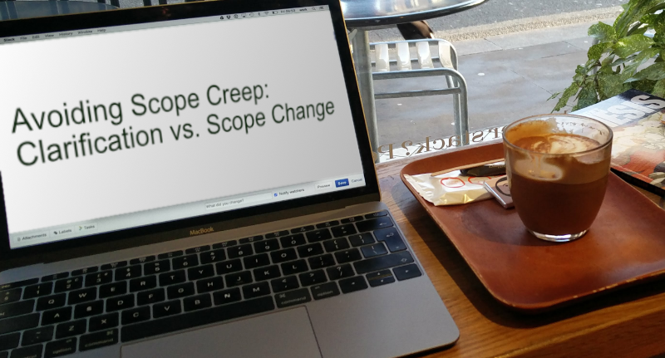
Claim Study: “Don’t let that scope creep!”
Project: Residential
Discipline: Civil Engineer
Details of Claim: Residential construction was 60%
complete when a landslide occurred, resulting in
significant damage. While the Insured’s contract explicitly
excluded design services for the retaining wall, the Insured
did opine on certain aspects of the retaining wall design while they were at the Project.
Damages: $7 Million
Lesson Learned: Only provide the services for which you are contracted.

Slide 16
Claim Study: “Don’t let that scope creep!”
Project: Design/construction of a warehouse
Discipline: Lighting design
Details of Claim: Bodily injury accident resulting from a trip and fall sustained by the Plaintiff resulting in spinal cord and neck injuries. It was alleged that the exterior lighting design failed to provide sufficient lighting in hazardous areas. Insured’s scope of services changed and another entity ultimately designed the exterior lighting. This change was never documented.
Damages: $5million
Lesson Learned: Document Document Document!

Slide 17
Compliance with All Laws:
“You’re the Expert! (Aren’t You?)”
“2.1.5 All professional design services and associated products or instruments of those services provided by the Project Consultant shall:
.1 Be in accordance with all applicable codes, laws, and regulations of any governmental entity, including, but not limited to…with the Owner serving as the interpreter of the intent and meaning of…any applicable code [.]”
School Board of Broward County v. Pierce Goodwin Alexander & Linville, 2014 WL 1031461
(Fla.4th DCA 2014)

Slide 18
Claim Study: “You’re the Expert! (Aren’t You?)”
Project: School
Discipline: Architect
Details of Claim: Renovation of a high school in Florida wherein the architect’s design was ultimately held to be not code compliant regarding fire safety issues. This resulted in increased construction costs.
Damages: Due to the language in the Architect’s contract regarding compliance with “all applicable codes”, the Court held that the Architect agreed to a heightened standard of care and was thus in breach of contract.
Lesson Learned: Again, the standard is reasonableness
School Board of Broward County v. Pierce Goodwin Alexander & Linville, 2014 WL 1031461 (Fla.4th DCA 2014)

Slide 19
Problems with “Compliance ALL with Laws”
Many laws have contradictory provisions
Not within a design professional’s expertise
Regulations and laws could change during the course of construction
Heightened standard of care

Slide 20
Compliance with Laws:
You Don’t Need to be the Expert
“Architect shall exercise usual and customary professional care in its efforts to comply with codes, regulations, laws, rules, ordinances, and such other requirements in effect as of the date of the execution of this Agreement.”

Slide 21
Summary: How to protect yourself
Know what your contract says
Get that contract reviewed: ask your PUI Agent or Insurance Carrier
Make sure the contract is signed by your client
Document your file
Keep the standards reasonable

Slide 22
Questions? Comments?
Roseanne DeBellis
Divisional Assistant Vice President
rdebellis@gaig.com
347.266.0803

