Slide 1




The Ins and Outs of Professional Liability Policies
Professional Underwriters, Inc.
Risk Management Seminar
March 2023
Roseanne DeBellis
Divisional Vice President
Great American Insurance Group

Slide 2

This course is registered with the AIA
Credit(s) earned on completion of this course will be reported to AIA CES for AIA members. Certificates of Completion for both AIA members and non-AIA members are available upon request.
CES for continuing professional education. As such, it does not include content that may be deemed or construed to be an approval or endorsement by the AIA of any material of construction or any method or manner of
handling, using, distributing, or dealing in any material or product.
______________________________
Questions related to specific materials, methods, and services will be addressed at the conclusion of this presentation.

Slide 3
The following presentation is for information and discussion purposes only. Any views or opinions expressed are the speakers’; shall not be construed as legal advice; and do not necessarily reflect any corporate position, opinion or view of Great American Insurance Company, or its affiliates, or a corporate endorsement, position or preference with respect to any contractual terms and provisions or any related issues. If you have any questions or issues of a specific nature, you should consult appropriate legal or regulatory counsel to review the specific circumstances involved.
The loss prevention information provided is intended only to assist policyholders in the management of potential loss producing conditions involving their premises and/or operations based on generally accepted safe practices. In providing such information, Great American does not warrant that all potential hazards or conditions have been evaluated or can be controlled. It is not intended as an offer to write insurance for such conditions or exposures. The liability of Great American Insurance Company and its affiliated insurers is limited to the terms, limits and conditions of the insurance policies underwritten by any of them.
Policies are underwritten by Great American Insurance Company and Great American Assurance Company, authorized insurers in all 50 states and the DC. The Great American Insurance Group eagle logo and the word marks Great American® and Great American Insurance Group® are registered service marks of Great American Insurance Company, 301 E. Fourth St., Cincinnati, OH 45202.

Slide 4
Agenda
What is Professional Liability
How Legal Liability for Design Professionals is Established
Your PL Insurance Policy
Difference Between a Claim and a Pre-claim
What Happens Next
Risk Management Fundamentals

Slide 5
What is Professional Liability Insurance?
Professional liability insurance is coverage that protects design professional firms and its employees against claims alleging negligent acts, errors, or omissions in the performance of design services.

Slide 6
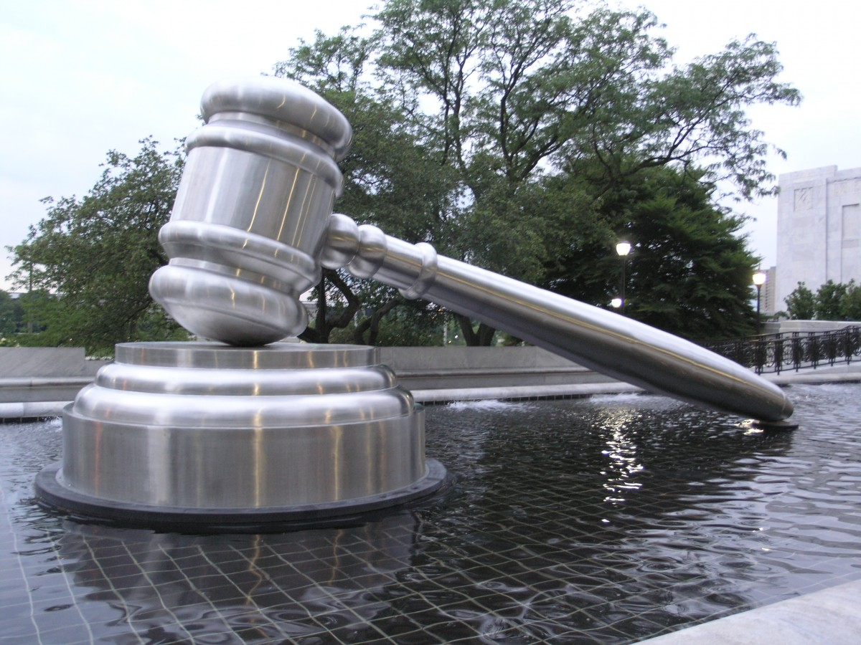
Legal Liability for Design Professionals
Duty*
Breach
Causation
Damages
*A legally sanctioned obligation

Slide 7
Source of Legal Liability for Design Professionals
Common Law
  Judge Made Law that has become precedent over time
Statute Law
  Codes and Regulations
Contract Law
  What the Parties Agree to do

Slide 8

Managing Risk for Design Professionals
Avoid
Retain and Mitigate
Transfer

Slide 9
Risk Transfer Limitations for Design Professionals
Contract
    Agreeable to all parties?
    Incompleteness of transfer
Insurance
    Policy Coverages and Exclusions
    Policy Limits and Deductibles

Slide 10
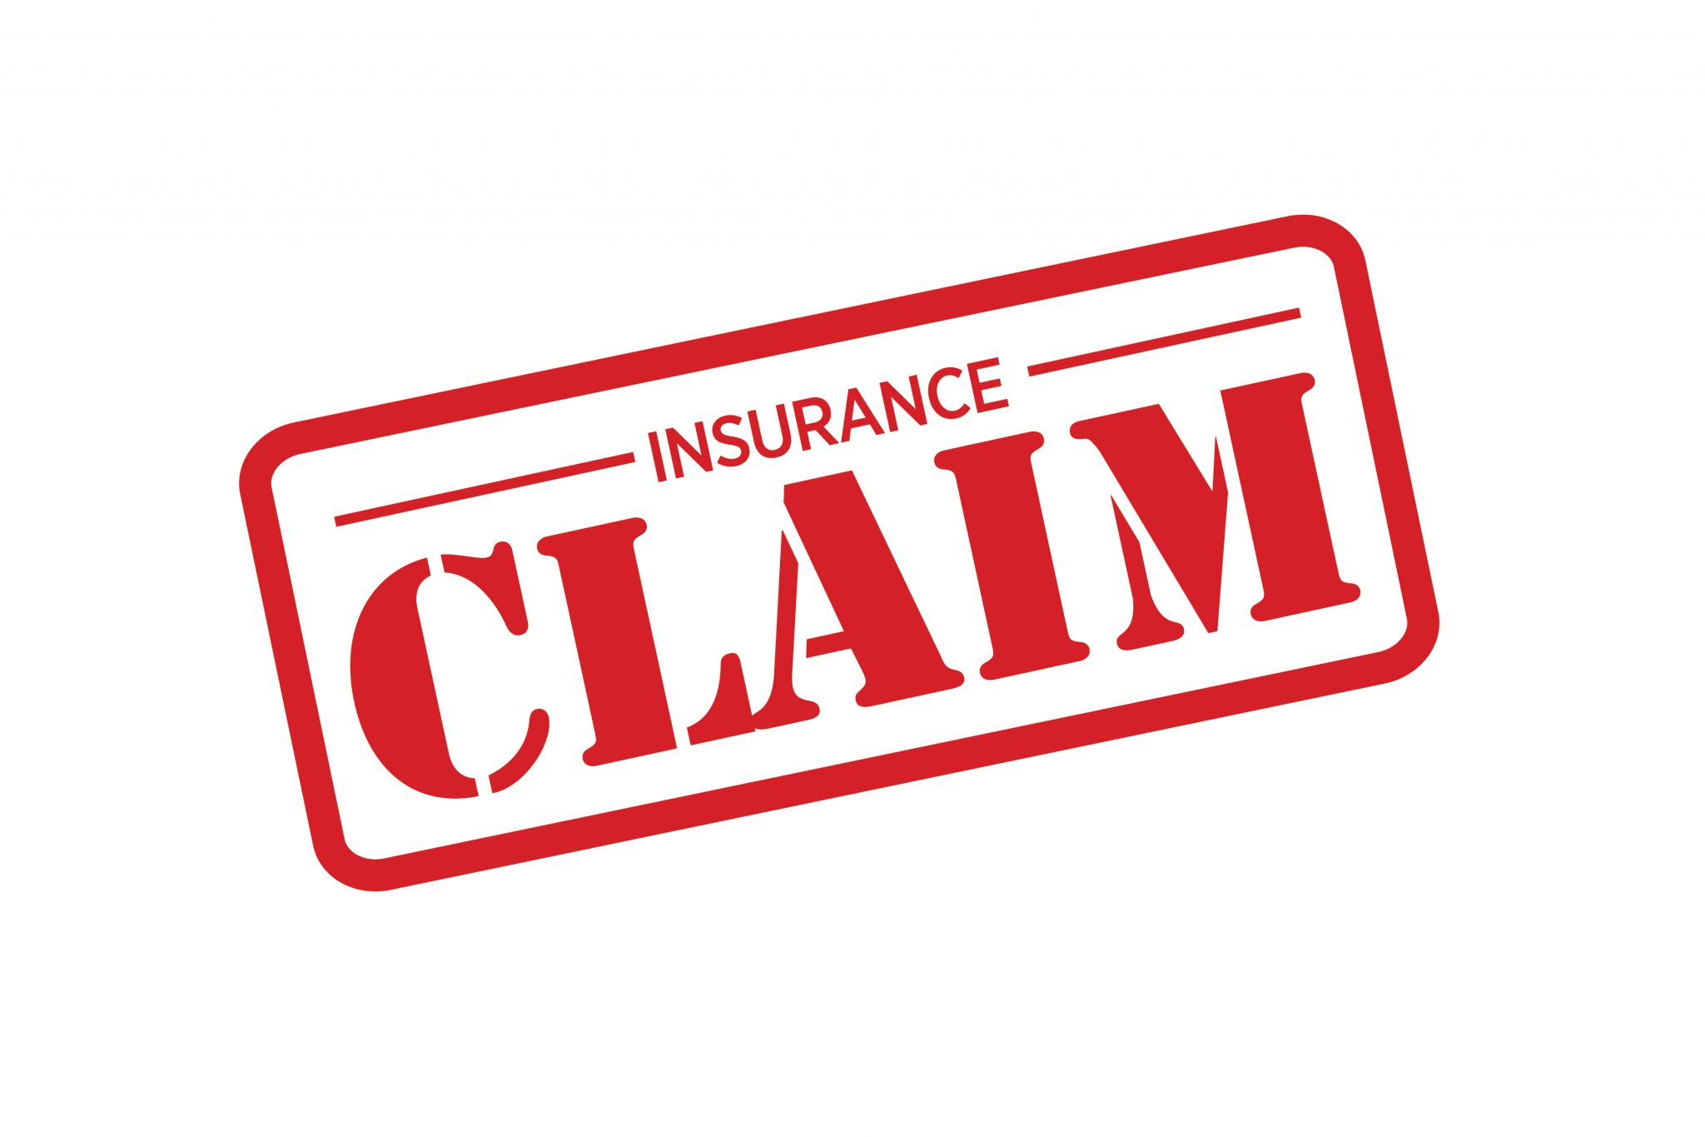
What to do when…
  …Your client is unhappy?
  …Someone is hurt on the jobsite?
  …Project is running way over budget?
  …Contractor is being replaced ?
  …You notice an error or omission?
…Notify your PUI Agent Immediately!
  PUI will report the matter to your insurance carrier
  Report will be set up, assigned a number
  In the meantime…do not admit liability or make promises!

Slide 11
Claim v. Pre-Claim: What is the difference?
Definition of a Claim
A demand for money or services, a lawsuit or a demand for arbitration
Potential Claims
Subpoenas, Notice-Only Letters
Why do I get a claim number if the matter is not an actual claim?

Slide 12
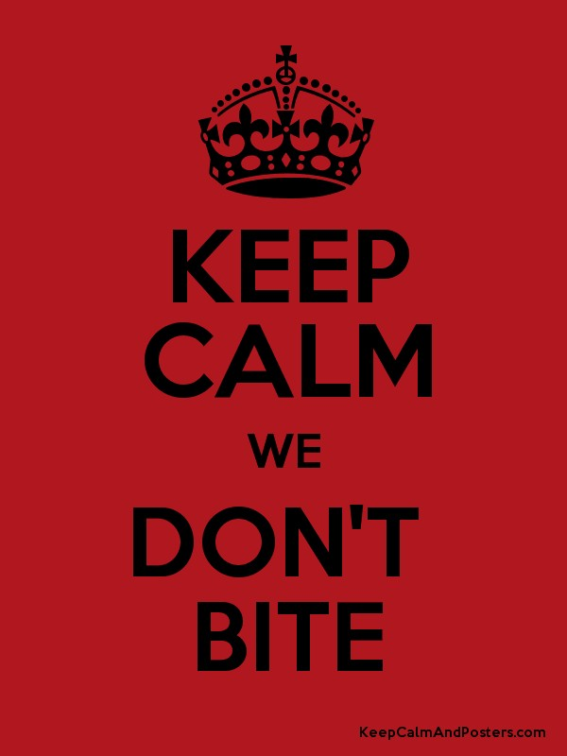
Your call with your Insurance Claim Representative
What to Expect:
General Discussion of the Project Background
Questions regarding your firm’s scope of services
Inquiries regarding history or ongoing issues at the Project; Business Relationships with other project participants
Request for your contract and relevant project documentation
Explanation of the Claims Representative’s role in the process and strategy moving forward
We work together!

Slide 13
Life of a Potential or Pre-Claim
Report it to your PUI Agent
Benefit in protecting your future interests
Pre-Claims Assistance-Counsel may be assigned to assist and protect against the possibility of a future claim
Claim Representative will check in every 30-45 days
Closure after 90 days if no developments
File can be reopened

Slide 14

Pre-Claims Assistance Success Story
Design Professional provided roadway design services, including cross section designs and traffic control plans. A drunk driver entered the roadway from the wrong direction, killing another driver. Pending lawsuit against the DOT and the Contractor. Insured receives potential claim letter and subpoena for documents.
Design Professional reports to broker and carrier and requests pre-claims assistance.
Defense counsel and expert were retained by GAIG on behalf of the Insured to participate in meetings and provide an expert opinion on the design.
Multiple meetings, discussions and on-site inspections over a one-year period.
Claim was resolved for $2.5million. Insured was never named as a defendant.

Slide 15
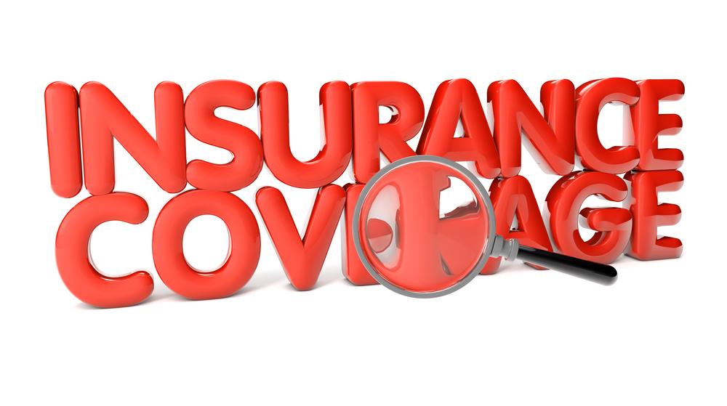
Coverage for the Claim under your Professional Liability Policy
Claim must arise out of your services as a Design Professional
Claims Made and Reported Policy: When was the claim made against you? When did you report it? (verse an Occurrence-based policy)
Claim Must be Made against the Named Insured (or an Insured) on the Policy

Slide 16
Coverage for the Claim under your Professional Liability Policy (Continued)
What is a retroactive date?
Exclusions may apply!
Is there other applicable insurance? (e.g. General Liability Insurance)

Slide 17
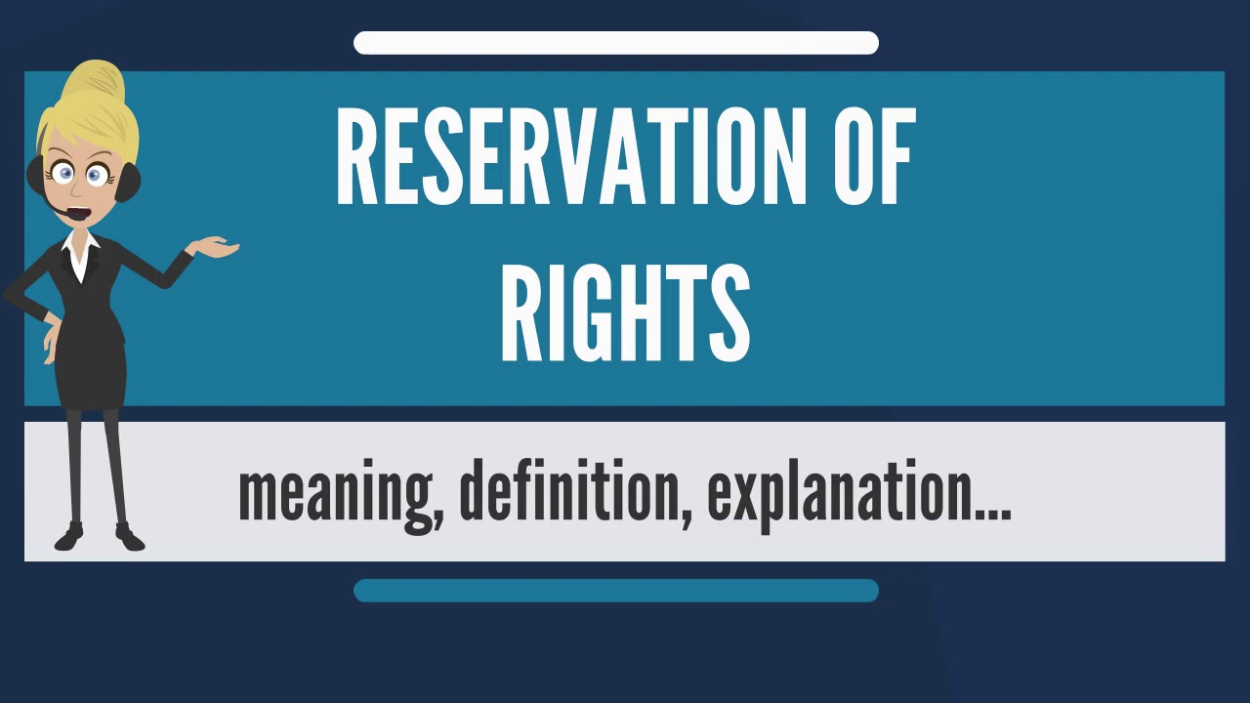
What is a Reservation of Rights Letter?
A reservation of rights letter typically serves as notice that the insurance company is reserving its right to deny coverage at a later date based on the terms of your policy. The letter neither denies the allegations in a claim nor is it a claims denial itself. While these letters appear generic, they are actually a formal indicator some of the losses claimed may not be covered. Often, receiving the letter also lets you know the information provided in the original claim requires further evaluation. ROR letters are used when an insurer identifies coverage defenses and/or policy defenses.

Slide 18
Poll: Is there Coverage Under the Policy?
The Named Insured on the Policy is ABC Engineering, Inc. A lawsuit was brought against ABC Engineering for negligence in the performance of engineering services. Does ABC Engineering have coverage?
ABC Engineering’s policy with GAIG period runs from January 1, 2022 to January 1, 2023. A lawsuit was filed and served on ABC on January 3, 2022 and the Insured immediately reports to GAIG. Is there coverage?
Same facts above, policy period runs from January 1, 2022 to January 1, 2023. A trip and fall incident occurs on January 1, 2022. A lawsuit is filed on January 1, 2024. ABC Engineering is not Insured with GAIG any longer. Is there coverage?
ABC Engineering’s policy has a retroactive date of January 1, 2022. The lawsuit claims that their design, which was done in 2015, was the cause of the bodily injury. Is there coverage?

Slide 19

Perks and Noteworthy Clauses in your Great American Policy
Pre-Claims Assistance
Early Resolution Credit
Mediation Credit

Slide 20
Your Claim is Covered! What’s Next?
Do you really need a lawyer? And how much will it cost? When does the deductible come into play?
Role and Benefits of Panel Counsel-Experts in Defending A/E cases
Get your documents ready!
Discovery process, review documents and work with Counsel to defend and/or resolve the case

Slide 21
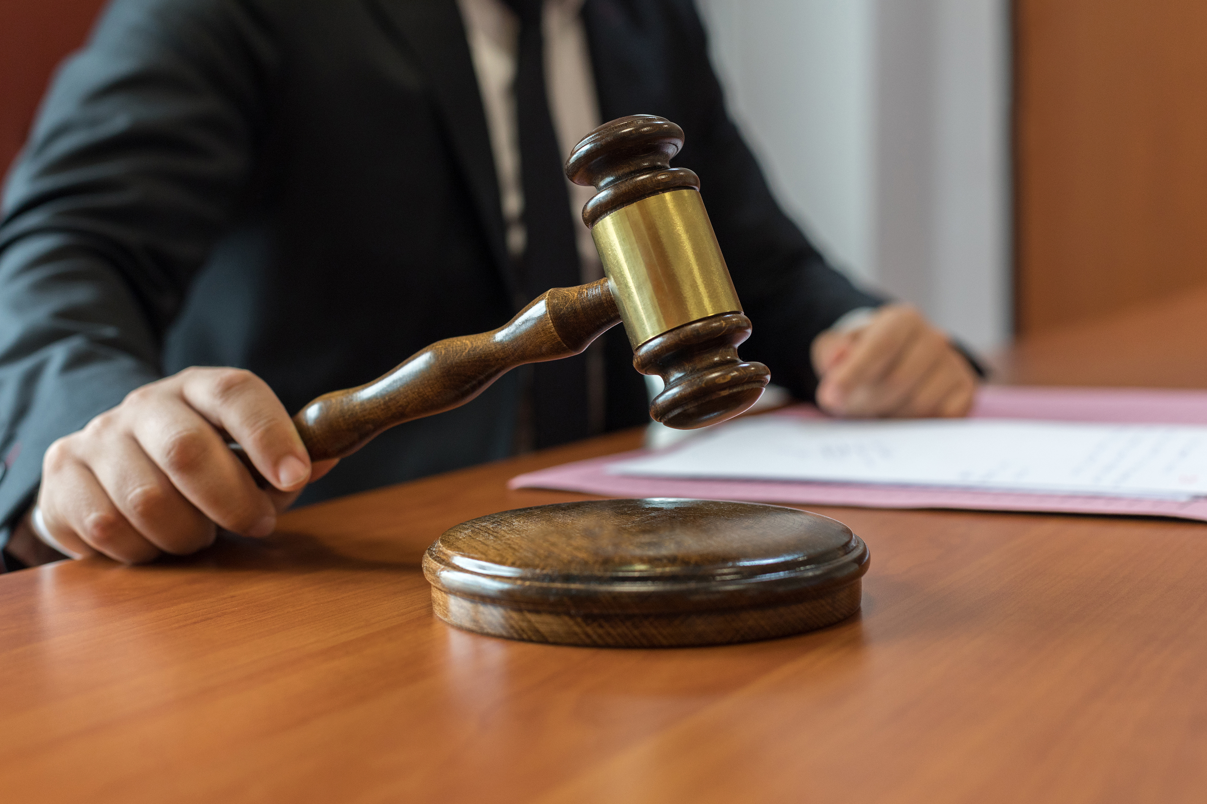
Litigation, litigation, litigation
Can be a lengthy process
Dealing with personalities of plaintiff, co-defendants and their attorneys
Written discovery and depositions
Experts/Consultants: Do we need them and why?

Slide 22
Mediation v. Arbitration v. Trial
Differences between mediation, arbitration and trial
Pros and Cons of each
What does your contract say? Does it dictate the ADR forum?
Trial: Judge or Jury? Did you waive your right to a jury trial?

Slide 23

Settlement-Common Questions
Are you admitting liability if you settle?
What happens to your insurance rates?
Benefits of settling early
Consent to Settle

Slide 24
Common Causes of Claims
Unreasonable client expectations
Run away or inexperienced contractors
Communication breakdown
Scope Creep

Slide 25
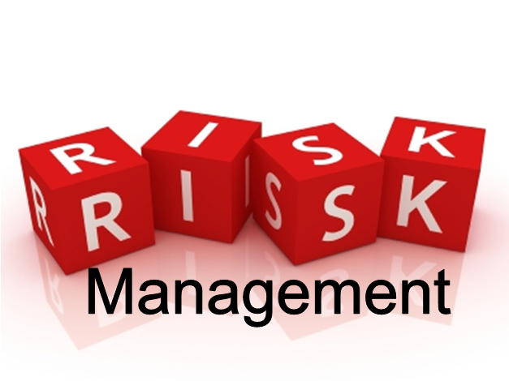
Risk Management: Your contract
Noteworthy contract clauses:
Limitation of liability
Alternative Dispute Resolution: Mediation clauses
Indemnification: Negligence based only
Standard of Care: There are no warranties or guarantees!

Slide 26
Risk Management: Other Tools to Protect Yourself
Do your research: Does this Owner or Contractor have a litigious history?
Are the subcontractors/subconsultants insured?
Communication throughout the project
Set realistic expectations with your client
Document, Document, Document
Carry sufficient insurance coverage

Slide 27
Sum it Up….
If you hear grumblings on a project site-talk to your PUI Agent
Report even if you think it is not important
Arm yourself with risk management tools
Litigation is a process, your insurance carrier is there to help!

Slide 28
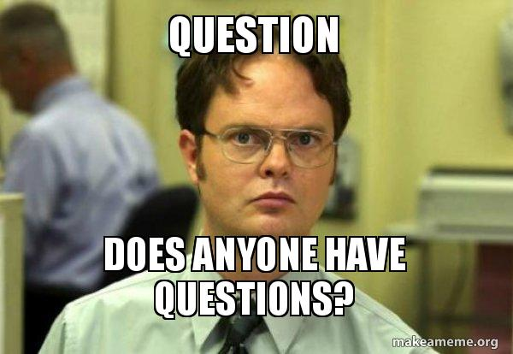
Questions? Comments?
Roseanne DeBellis
Divisional Vice President
rdebellis@gaig.com
347.266.0803

