Slide 1
Travelers’ Design Professional Liability What You Need to Know About Your Professional Services Contract
Speaker:
Sarah Chambers, Esq.
Claims Counsel| Professional Liability

Slide 2
Agenda
How Legal Liability for Design Professionals is Established
Types of Contracts
Select Contract Clauses
Certification
Copyrights
Indemnity
Opinions of Probable Cost
Standard of Care
Warrantees
Contract Clauses That May Need Special Attention
Resources from Travelers

Slide 3
Elements of Legal Liability
Four elements are required to establish legal liability
Duty
Breach
Causation
Damages

Slide 4
The Sources of Duty
What sources establish what a Design Professional should or should not do?
Common Law
What is expected of you as a professional established by your peers
Statutory Law
Obligations established by government bodies and agencies
Contract
What two parties promise to each other

Slide 5
Types of Contracts
Oral Agreements
Letter Agreements
Purchase Orders
Standard Form Agreements
Custom Agreements

Slide 6
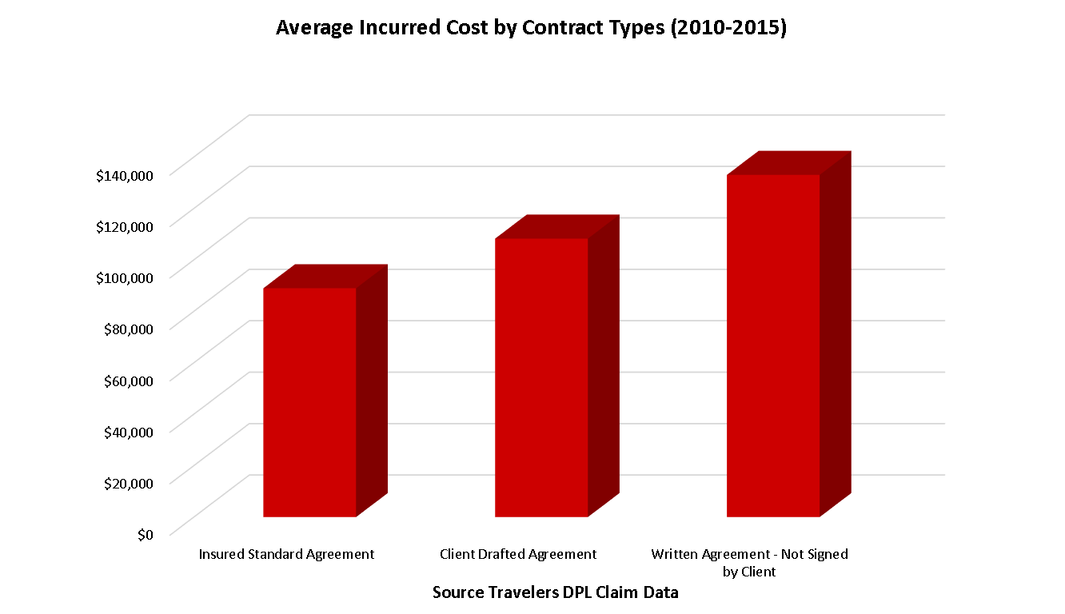
Types of Contracts

Slide 7
Certifications - Problematic
Upon completion of the Project or such other time as required for the Client's benefit, Design Professional shall provide all certifications necessary for the construction and occupancy of the project.

Slide 8
Certifications - Response
Certificates requiring Design Professional’s signature shall be submitted to the Design Professional for review at least ten (10) days prior to the requested dates of execution. Design Professional shall not be required to execute certificates that would require knowledge, services or responsibilities beyond the scope of this Agreement. Design Professional shall not be required to sign any document that would result in Design Professional having to certify beyond the Design Professional’s professional opinion or on information or conditions unknown by the Design Professional.

Slide 9
Copyrights - Problematic
Drawings, specification and other instruments of the Design Professional’s services under this agreement are “Works Made for Hire.” Upon completion or termination of services, Client may use drawings and specifications, without limitations, for the completion, addition to, or maintenance of this project or design and construction of similar projects

Slide 10
Copyrights - Response
Instruments of Services are drawings, specifications, models, etc. including those in electronic form prepared by the Design Professional with respect to this Project. Upon execution of this Agreement, Design Professional grants to Client a nonexclusive license to use Design Professional’s Instruments of Service solely and exclusively for purposes of constructing, using, maintaining, altering and adding to the Project, provided that Client substantially performs its obligations, including prompt payment of all sums when due, under this Agreement.
Client assumes full responsibility for any unauthorized use of Design Professional’s Instruments of Service and shall indemnify and defend the Design Professional for any claims that may arise from such unauthorized use.

Slide 11
Indemnity - Problematic
Design Professional shall defend, with counsel selected by the client, and indemnify the Client, its officers, employees, agents and subsidiaries with respect to any demand, claim, liability, costs, expenses, fines, or penalties to the extent caused by the Design Professional’s professional negligence, gross negligence, error, omission, or willful misconduct in any way related to the Project or this Agreement or breach of this Agreement. Client shall indemnify the Design Professional for the Client’s sole negligence.

Slide 12
Indemnity- Response
Client and Design Professional, to the extent permitted by applicable law, shall each indemnify the other with respect to any demand, claim, liability, costs, expenses, fines, or penalties to the extent caused by such Party’s negligent act, error, or omission in any way related to the Project or this Agreement. In the event of any claim, allegation, or demand by any third party involving the negligent performance of the scope of services or responsibilities of either Party, such Party shall promptly assume responsibility for the investigation, defense, and response to such issues.

Slide 13
Opinions of Cost - Problematic
At the end of construction documents, Design Professional shall provide the Client with a cost estimate and represents that estimate will conform with the owner’s budget. If the lowest acceptable bid exceeds Client’s budget, the Design Professional shall preform additional services at its own cost to bring the bid within the Client’s budget. Modification to the Design Documents shall be at the Design Professional’s own cost.

Slide 14
Opinions of Cost - Response
Evaluations of the Client’s budget for the Project, the preliminary estimate of the Cost of the Work, and any updated estimates of the Cost of the Work prepared by the Design Professional represent the Design Professional’s judgment as a Design Professional familiar with the construction industry. It is recognized, however, that neither the Design Professional nor the Client has control over the cost of labor, materials or equipment, over the Contractor’s methods of determining bid prices, or over competitive bidding, market, or negotiating conditions. Accordingly, the Design Professional does not warrant or represent that bids or negotiated prices will not vary from the Client’s budget for the Project, or from any estimate of the cost work evaluation prepared or agreed to by the Design Professional.

Slide 15
Standard of Care - Problematic
Design Professional’s represents that the services provided will be consistent with the highest standard of care applicable to such services. If the client determines that the Design Professional has not met the applicable standard of care, the Client may at its own discretion, promptly terminate the agreement.

Slide 16
Standard of Care- Response
Design Professional’s services shall be provided consistent with and limited to the standard of care applicable to such services, which is that Design Professional shall provide its services consistent with the professional skill and care ordinarily provided by Design Professionals practicing in the same or similar locality under the same or similar circumstances. Such standard of care is not a warranty or guarantee, and Design Professional shall have no such obligation.

Slide 17
Warranties - Problematic
Design Professional represents that the project when completed will be fit for its intended purposes, will meet the requirements to achieve USGBC’s Platinum certification and will after one year show an energy use of 15% less compared to the energy use of similar projects.

Slide 18
Warranties - Response
Design Professional warrants that it is properly licensed to perform the services under this Agreement and that it shall perform the services in accordance with the applicable professional standard of care. No other expressed or implied warranties or guarantees are created related to this agreement or the professional services to be provided.

Slide 19
Questions
?

Slide 20
Clauses That May Need Special Attention
Limitation of Liability
Prevailing Party Clause
Waiver of Trial by Jury

Slide 21
Claim Study
Client retained architect as the prime design professional for the construction of a new operations center.
Architect retained civil engineer to provide services for site access
Contract between the architect and civil engineer included a limitation of liability clause.
No such provision in the client and architect agreement.

Slide 22
Claim Study
After completion, the client determined that the largest vehicles could not pull into the bays and claimed damages in excess of $500,000.
Civil engineer asserted the defense of its limitation of liability leaving the Architect vicariously liable for the amount above the limit for what was alleged to be a civil engineering error.
The claim was settled during mediation for just over $300,000.

Slide 23
Resources from Travelers
Guide to Professional Service Agreements & Sample Contract
Guide for Contract Review
What You Need to Know About Your Professional Services Contract webinar recording
New Newsletter and AskHomer@Travelers.com
New risk management website in 2017

Slide 24
Questions
?

