Slide 1
Travelers PUI Risk Management Seminar Claim Data and Claim Statistics March 12th-13th, 2019
Speaker:
Trish Grogan, Esq.
Director of Risk Management and Large Firm UW | Travelers

Slide 2
Travelers Disclaimer
The views expressed in these materials are those of the author and do not necessarily reflect the views of The Travelers Companies, Inc. or any of its subsidiary insurance companies (“Travelers”). This material is for general informational purposes only and is not legal advice. It is not designed to be comprehensive and it may not apply to your particular facts and circumstances. Consult as needed with your own attorney or other professional adviser. This material does not amend, or otherwise affect, the provisions of any insurance policy issued by Travelers. It is not a representation that coverage does or does not exist for any particular claim or loss under any such policy. Coverage depends on the facts and circumstances involved in the claim or loss, all applicable policy provisions, and any applicable law. Availability of coverage referenced in this document can depend on underwriting qualifications and state regulations. Claims scenarios are based on actual claims, composites of actual claims, or hypothetical situations. Resolution amounts are approximations of both actual and anticipated losses and defense costs. Facts may have been changed to protect confidentiality.

Slide 3
Definitions
Frequency
A claim has been made
“demand for money or services…”
Severity
What the insurance company paid
Does not include a firm’s deductible
Does not include amounts over the policy limits

Slide 4
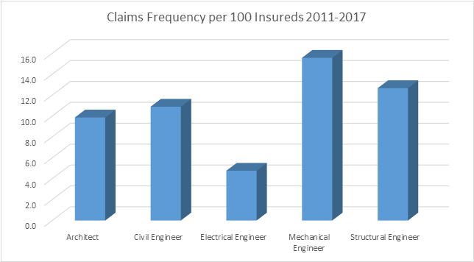
What are the Chances of a Claim by Discipline?
Source: Travelers DPL Claim Data

Slide 5
What Will a Claim Cost by Discipline?
Source: Travelers DPL Claim Data

Slide 6
What is the Cost of Defense?
Source: Travelers DPL Claim Data
Notes:
We see here that roughly 65% of all claims close with $0 paid for damages. But regardless, each claim involves members of the firm. Can you give us a few examples of the types of things members of the firm have to do to assist with there defense?

Slide 7
Know Your Client
Source: Travelers DPL Claim Data

Slide 8
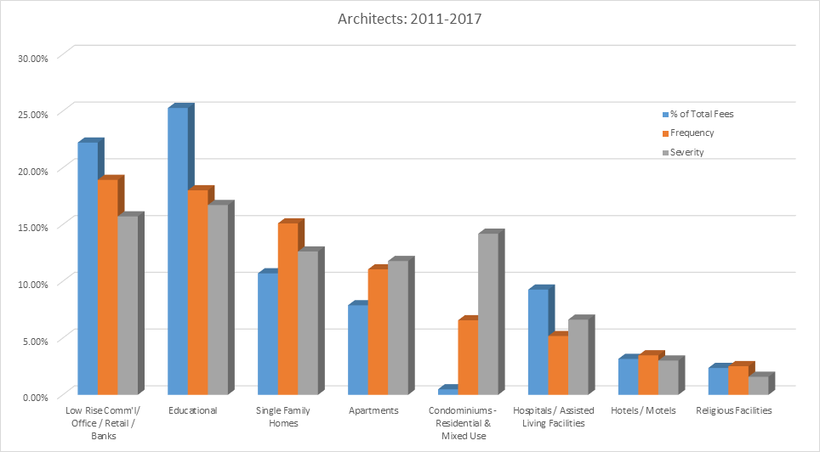
Know Your Project - Architects

Slide 9
Claim Scenario
Owner retained architect to perform certain design services for the build-out of an existing industrial warehouse facility.
A fee dispute between the construction company and the owner materialized and the construction company filed suit against the owner for unpaid fees.
Owner filed a counterclaim against the construction company asserting delay issues, and a joinder of the architect, who was the prime design firm on the project, as well as the architect’s mechanical subconsultant and electrical subconsultant.
Design claims were primarily based on including HVAC units that were installed improperly, rooms that were not holding their temperature based on inadequate HVAC design and placement, and that the electrical system was both improperly installed and inadequate.

Slide 10
Claim Scenario
There were no contracts by or between any members of the design team. The architect and mechanical subconsultant were friends outside of their professional relationship.
While the mechanical subconsultant had professional liability insurance and was defended by its carrier, the electrical subconsultant did not carry his own professional liability insurance and was defended by the architect’s insurance company.

Slide 11
Claim Scenario
Damages related to faulty mechanical/HVAC system design were claimed to be $599,000. Damages claimed related to the electrical design were $210,000.
As to the architect, the matter settled at mediation for a $150,000 contribution which covered the electrical engineer’s liability.
Total defense costs for the architect/electrical subconsultant exceeded $110,000.

Slide 12
Lessons Learned
Trigger of Claims
Sometimes, a claim against you can arise from an unrelated issue, such as a fee dispute between other parties.
Client Selection/Relationship Documentation
Avoid entering into informal agreements with subconsultants or clients simply because the subconsultant is familiar to you (no insurance, poor work product, etc.)
Standard of Care
A subconsultant’s standard of care violations can have a negative impact on you.

Slide 13
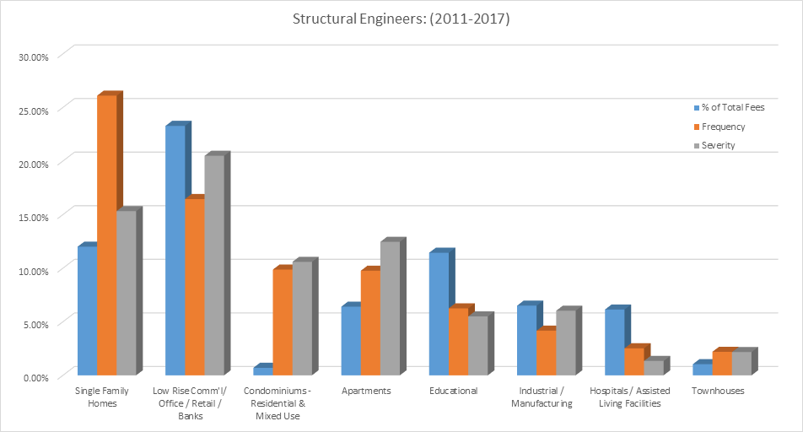
Know Your Project-Structural Engineers
Source: Travelers DPL Claim Data

Slide 14
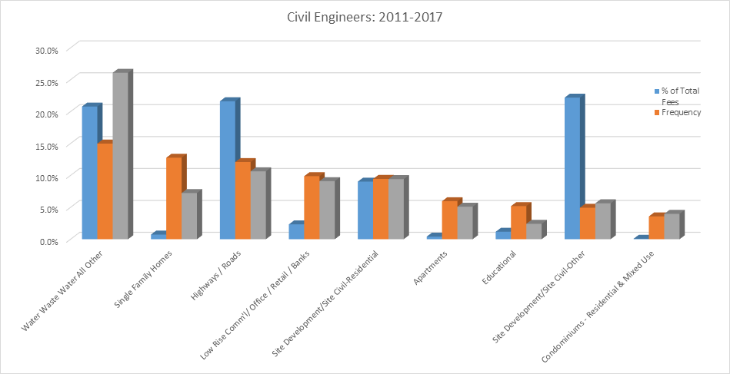
Know Your Project – Civil Engineers
Source: Travelers DPL Claim Data

Slide 15
Claim Scenario
City contracted with Civil Engineer to provide design services for a water treatment plant
Civil engineer retained a Structural Engineer
Several design options were presented and the City chose the most cost effective system, which was a unique system both for the geographical area and for the type of water being treated at the plant
After the plant was constructed, the City claimed that the water treatment system was not working properly
Notes:
“Should an insured attend a deposition, even if they are not party to the claim, without notifying their broker and PL carrier?” This is a chance to talk about the value of pre-claim.

Slide 16
Claim Scenario
There was some indication that the City was not operating or maintaining the system correctly
The City argued that the Civil Engineer failed to inform them as to the system’s requirements for operation and maintenance
There was also an issue with the structural design of the foundation
An expert determined that the structural portion of the project was substantially under designed

Slide 17
Claim Scenario
Although the Civil Engineer had hired the Structural Engineer, the Civil Engineer stamped the structural drawings
In this jurisdiction, stamping the drawings was akin to ratifying the design, which made the Civil Engineer primarily liable for the structural issues
Also at the time of the claim, the structural engineer was out of business and had no insurance
The City filed suit against the Civil Engineer for breach of contract and professional negligence alleging $2,000,000 for repairs

Slide 18
Claim Scenario
Given the opinion from the expert and the lack of any documentation regarding instructions for operation and maintenance of the plan, defense would be difficult
Because the Civil Engineer stamped the structural drawings and the status of the structural engineer, it likewise was going to be difficult to assign any liability to the Structural Engineering.
Matter was ultimately resolved for a payment of over $665,000. Significant sums were also spent on defense expenses

Slide 19
Lessons Learned
Submittals/Subconsultant Design
Let subconsultants stamp their design drawings
Communication
Clearly communicate the benefits and risks associated options presented. And if you ultimately are not comfortable with one or more of the options, consider not presenting any option that is not time-tested and proven
Documentation
Document your conversations including any conversations about operation and maintenance that may be unique or not the norm

Slide 20
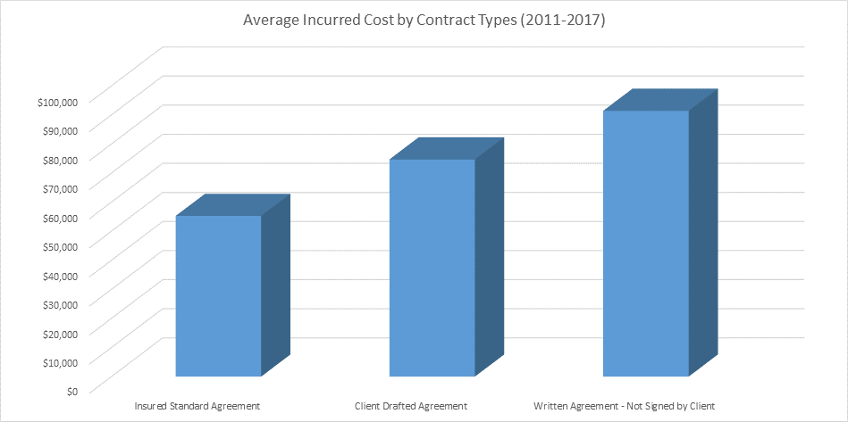
Know Your Contracts

Slide 21
More on Contracts
Contracts
Review a continuing services contract periodically to ensure it contemplates the scope of services being provided
Responsibilities of all parties are clearly defined
State that the design profession as no responsibility for construction site safety and state who does have that responsibility
Include special provisions such as indemnities when necessary

Slide 22
Summary
Statistical information and claims studies can help determine potential risk of:
The client
Public and private entities pose different types of risk
The professional services
This includes the services you may not be providing
The project
Some projects pose a higher risk than others
The contract
Can help or may increase your risk
Notes:
“Final thoughts/comments?”

Slide 23
Questions
?

Slide 24
RISK MANAGEMENT
“Not taking risks one doesn't understand is often the best form of risk management.”
Raghuram Rajam

Slide 25
TRV RESOURCES
Pre Claims Assistance
Contract Review Service
Webinars (AIA certified)
Quarterly Newsletters
Contract Review Guide
Risk Control.com website https://www.travelers.com/professional-liability-insurance/design-professionals
In-house Seminars

Slide 26
Integration
Ways to integrate TRV RM into
your business:
1) Use Free Pre Claims Loss Prevention Assistance
2) Training Session: Use TRV Contract Review Guide to review company contracts
3) Contract Review Services

Slide 27
Ways to integrate TRV RM into your business (continued):
4) Ensure that your company contact is correct to get newsletter
5) Request in-house seminars
6) Participate in our large firm webcasts/calls/events
7) Particular RM question or recommendation contact us! Trish Grogan/ Joe Jones/ Claims Attorneys

Slide 28
Specific Concerns for Design Professionals in Michigan

Slide 29
Questions
?

