Slide 1
Copyright Protection for Architectural Plans and Works
Thomas F. Waggoner
Straub, Seaman & Allen, P.C.
twaggoner@lawssa.com

Slide 2
Overview
Intellectual Property
Copyright Act of 1976
Architectural Works Copyright Protection Act of 1990
Berne Convention of 1989
Key definitions and concepts
Copyright your work
Prima facie case
Real world example
Questions

Slide 3
Intellectual Property
Patents
Title 35
Trademarks
Title 15
Copyright
Title 17
Trade Secrets
Title 18

Slide 4
Patents: Patents protect new, useful, and non-obvious inventions, i.e. it protects ideas, concepts and useful articles. An invention can be a device, a structure, process, machinery, etc.
Protected for a term of years
Trademarks: Trademarks protect source identifications, usually for brands, slogans, logos, or designs.
May be protected perpetually
Copyrights: Copyrights protect original textual works and visual or artistic expressions, i.e. it protects the creative expression of an idea or concept in a tangible format. That is the way an idea or concept is expressed. It does not protect useful articles – except “buildings”.
Protected for a term of years
Trade Secrets: Trade secrets protect valuable secret information like ideas that must be kept confidential.
May be protected perpetually

Slide 5
Copyright Legislation
Copyright Act – 1976
Protection of architectural plans and drawings as “pictorial, graphic, or sculptural” works.
Berne Convention for the Protection of Literary and Artistic Works – 1989
Architectural Works Copyright protection Act – 1990
Protection of “architectural works”

Slide 6
The Basics
key concepts
protected rights
protected categories of work
copyright owners
general rules – duration, copyrighting works, SOL
Prima facie proof of infringement

Slide 7
Key Concepts
original creator or author of a work is the first owner of copyright (with some exceptions)
copyright is automatic, no registration is required
owning the item does not mean you own the copyright
law does not distinguish between commercial and non-commercial uses

Slide 8
What is a Work?
expression of an idea in tangible form
published or unpublished
commercial or non-commercial
criteria of a work
must be “fixed” in some form
original

Slide 9
What does a copyright let you do?
Copyright is more than just the right to copy
It grants the sole and exclusive right to control the use of the work and benefit from its exploitation, such as the right to:
Reproduce the work;
Distribute the work;
Display the work; and
Make derivative works.
EXCEPT . . .

Slide 10
In the context of a copyrightable “building”, the author cannot prevent:
(1) The photographing of a building that is “ordinarily visible from a public space”; or
(2) The owner of the building from altering or destroying the building; or
(3) Safe Harbor use of plans?

Slide 11
Protected Categories of Works
17 U.S. Code § 102
(a) Copyright protection subsists, in accordance with this title, in original works of authorship fixed in any tangible medium of expression, now known or later developed, from which they can be perceived, reproduced, or otherwise communicated, either directly or with the aid of a machine or device.

Slide 12
Works of authorship include the following categories:
…
(5) pictorial, graphic, and sculptural works
…
(8) architectural works

Slide 13
(b) In no case does copyright protection for an original work of authorship extend to any idea, procedure, process, system, method of operation, concept, principle, or discovery, regardless of the form in which it is described, explained, illustrated, or embodied in such work.

Slide 14
Drawings That Can be Copyrighted – (a)(5)
Architectural drawings, blueprints, details, floor plans, elevations . . .
Technical or mechanical drawings
Diagrams
Models

Slide 15
“Thin” Protection
Technical drawings that exhibit a relatively low degree of expressive content have been termed “thin” by the United States Supreme Court.
Feist Publ’ns v. Rural Tel. Serv. Co., 499 U.S. 340, 349, 111 St. Ct. 1282, 113 L.Ed.2d 358 (1991).

Slide 16
As-Built items generally do not infringe copyright
Why? the As-Built item is considered a “useful article”, while the drawing is not.
“A useful article is an article having an intrinsic utilitarian function that is not merely to portray the appearance of the article or to convey information.”

Slide 17
“Artistic craftsmanship” exception.
Think: stained glass, tapestry, wallpaper
Some courts increased damages to compensate

Slide 18
Examples -
Not protectable standing alone:
The placement of a building on a lot, the creation of a continuous traffic loop through a hospital complex, the placement of emergency services and ambulance parking along a roadway, the arrangement of space on a particular floor

Slide 19
What is an (a)(8)“architectural work”?
An “architectural work” is the design of a building as embodied in any tangible medium of expression, including a building, architectural plans, or drawings. The work includes the overall form as well as the arrangement and composition of the spaces and elements in the design, but does not include individual standard features.

Slide 20
What is a building?
Regulations define “building” as “humanly habitable structures that are intended to be both permanent and stationary, such as houses and office buildings, and other permanent and stationary structures designed for human occupancy, including but not limited to churches, museums, gazebos, an garden pavilions.””

Slide 21
Examples
Buildings:
Homes, condominiums, skyscrapers, restaurants, garden pavilion, modular housing, churches, museums, pergolas, gazebos
Maybe buildings:
Parking garages, monumental, nonfunctional works of architecture (e.g. St. Louis Arch; Statute of Liberty)
Not Buildings:
Kiosks, mobile homes, tents

Slide 22
Who Owns the Copyright?
Original Creator
A certificate of copyright registration is prima facie evidence of ownership of a valid copyright.
Work-Made-For-Hire – if a design firm hires an architect or engineer as an employee, and the employee produces an original work, the design firm owns the copyright.

Slide 23
Joint authorship – two or more authors who intended to create an “inseparable or interdependent unitary whole.” Think: consultants
Transfer Ownership in Writing
Unintentional Transfer – did you grant a an implied nonexclusive license

Slide 24
AIA Documents
The standard American Institute of architecture (AIA) contract provides that “the architect shall be deemed the author of the documents and drawings prepared with respect to [a particular] project and shall retain all rights to said documents including copyrights.”

Slide 25
The standard AIA contract also provides that the documents and drawings “shall not be used by the owner or others on other projects, for additions to this Project or for completion of this Project by others, unless the architect is adjudged to be in default under this agreement, except by agreement in writing with appropriate compensation to Architect.”

Slide 26
Duration of copyright
general rule
life of author + 70 years = public domain
If joint work, life of last surviving author + 70 years = public domain

Slide 27
Except in the case of…
Works Made For Hire
work created by an employee in course of work then employer owns copyright
95 years from date of publication
120 years from date of creation
Whichever is shorter
Publication is the distribution of copies of a work to the public by sale or other transfer of ownership or rental, lease, or lending.

Slide 28
Statute of Limitations
Copyright infringement has a three-year statute of limitations from the date of the last infringement regardless of when the first infringement occurred.
“No civil action shall be maintained under the [Act] unless it is commenced within three years after the claim accrued.” 17 U.S.C. §507(b).
BUT damages limited to three-year-statutory period.

Slide 29
Prima Facie Copyright Infringement
In order to establish a prima facie case of copyright infringement, a plaintiff must prove:
(1) ownership of the copyright; and
(2) that the defendant engaged in unauthorized copying of the constituent elements of the work that are original.

Slide 30
Proofs
Direct evidence of the physical act of copying; or
Indirect proof by demonstrating that defendant had (1) access to the copyrighted work; and (2) prove “substantial similarity”
“Substantial similarity exists where an average lay observer would recognize the alleged copy as having been appropriated form the copyrighted work.”

Slide 31
Particularized audience: when the ordinary observer is the member of an intended audience rather than the general public, the test is from the viewpoint of the particularized audience, i.e. architects, engineers, builders.
Site plans, details, blueprints

Slide 32
But not all copying is infringement. The substantial similarity analysis focuses on the similarity of expression. That is, the elements susceptible to copyright protection.
Idea/expression dichotomy – no author may copyright his ideas, procedures, process, system, method of operation, concept, principle, discovery, or the facts he/she narrates.

Slide 33
Copyright for your works
Copyright is automatically created when a copyrightable work is fixed in a tangible medium.
Notice is no longer required, but recommended to avoid (1)infringements and (2)innocent infringement defense.
Notice consists of the symbol ©, “copyright” or “Copr.” along with year of first publication and the name of the copyright owner.

Slide 34
Registration creates a record of the copyright.
Must register before you can file an infringement suit.
If register (a) within three months of publication; or (b) before infringement, you can recover attorney fees, court costs and statutory damages up to $150,000 per infringement, rather than actual damages (e.g. lost profits, additional profits of the infringer, and injunction)
If register within five years of first publication it will constitute prima facie evidence of the validity of the copyright.

Slide 35
Registration
United States Copyright Office
Copyright.gov
On-line applications
Form VA – Architectural Works
Form VA – Pictorial, Graphic, or Sculptural Works
Deposit two copies of published works with Library of Congress
Deposit one copy of unpublished works and published on-line works with Library of Congress
FILE TWO APPLICATIONS
Fee: on-line $35
paper $65

Slide 36
Resources
Library of Congress
U.S. Copyright Office
Publications Section
101 Independence Ave, SE # 6304
Washington , DC 20559-6304
Circular 1, Copyright Basics
Circular 2, Copyright Registration
Circular 3, Copyright Notice
Circular 41, Copyright Registration of Architectural Works
Compendium of U.S. Copyright Office Practices: Chapter 900

Slide 37
Example: Trump Palace/Trump Royale
Paul Oravec vs. Sunny Isles Luxury Ventures, L.C. et al, 527 F.3d 1218 (2008)
Alternating concave and convex sections*
Three prominent elevator shafts that protrude above the roof of the building*
Rounded building ends
Constant radius curves
Holes in the building
A twin tower design
See-through floor plans
A circular plaza
A central fountain
A rooftop pool and landscape elements

Slide 38
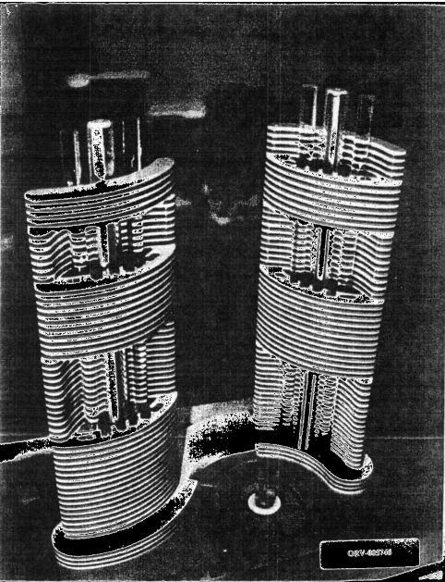

Slide 39
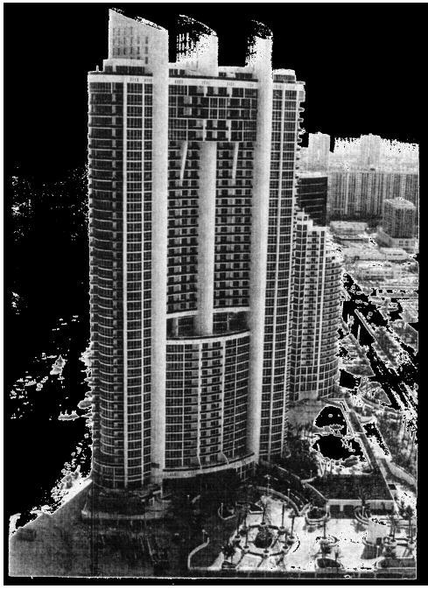

Slide 41
Questions?

