Slide 1
What would you do?
Bodily Injury Claims and the
Design Professional
Professional Underwriters Inc. Risk Management Seminar
March 2017

Slide 2
Navigators Team
Roseanne DeBellis
Senior Claims Counsel | Danbury, CT
Allison Esrig
Vice President | Ellicott City, MD
Disclaimer: This material is for informational purposes only, and nothing contained herein should be considered the rendering of legal advice or determination of coverage. You should always consult with an attorney before acting on anything contained in this material, as facts and circumstances will vary from case to case. Comments and opinions are based on The Navigators Group’s experience in loss prevention and on the general scope of insurance coverage offered under the Navigators Insurance Company ‘s policy.

Slide 3
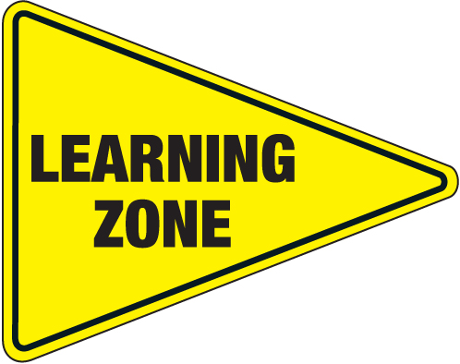
Introduction
What would you do?
Review five bodily injury claims
Construction observation and site safety reminders
Contract recommendations
Insurance coverages

Slide 4
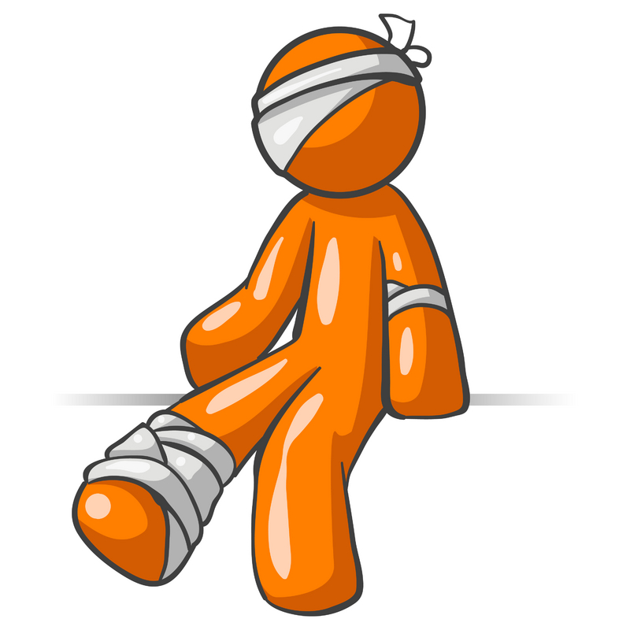
There is an injury on your project! What now?
Notify your insurance agent/carrier
Do not accept responsibility or admit fault
Gather your project documentation, especially your contract
Keep your distance

Slide 5
Claim Study #1
Discipline: Architect
Project: Conversion of an aircraft hangar into an auto repair training facility
Services: Prepare preliminary floor plans for the renovation project
Facts: 70 Students assisted with the demolition of the hangar which contained asbestos material
Claimed damages: $37 Million

Slide 6
Claim Study #2
Discipline: Structural Engineer
Project: Renovation of a pharmaceutical plant
Services: Provide structural engineering designs and limited site visits
Facts: Subcontractor was electrocuted when utilizing drilling equipment at the project
Claimed Damages: $27 Million

Slide 7
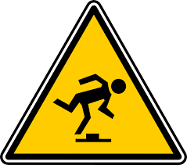
Claim Study #3
Discipline: Land surveyor
Project: School playground
Services: Providing surveying services for the school with the control point set by our insured
Facts: “Trip and fall” by a kindergarten teacher who allegedly tripped on a control point in an elementary school playground
Claimed Damages: $1 Million

Slide 8
What Would You Do? Fight or Settle?

Slide 9
Construction Observation and Site Safety Reminders
Contractually exclude jobsite safety responsibility
If you observe a dangerous situation on a jobsite:
Alert those in immediate danger
Remove your staff from the danger zone
Verbally notify the person responsible for safety onsite
Provide immediate notification in writing to the owner and contractor of your observation
Remember your scope of services
DO NOT STOP CONSTRUCTION OR RECOMMEND A SOLUTION!

Slide 10
Limit Scope of Services in a Contract
Specify what you will do
Specify what you will not do
Additional services extra
Do not accept responsibility for jobsite safety

Slide 11
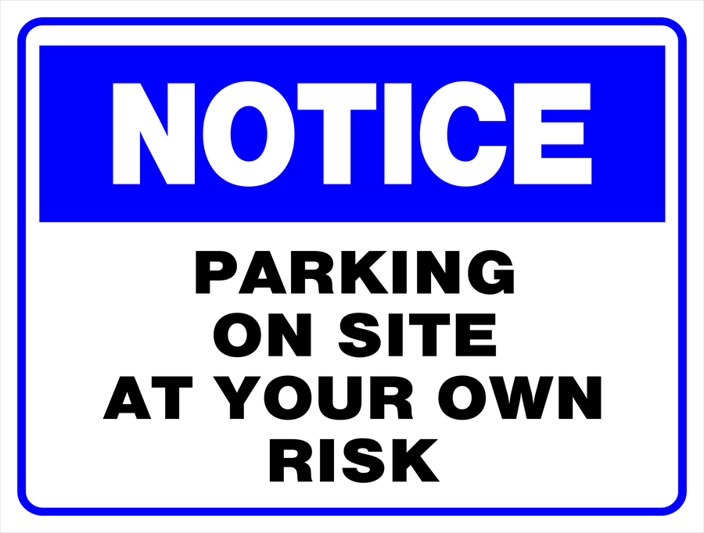
Claim Study #4
Discipline: Structural engineer
Project: Casino parking garage
Services: Assessing and repairing connections to columns that served as safety barriers inside the garage
Facts: Casino patron drove into a barrier of a parking garage and fell off the 5th level sustaining serious injuries
Claimed Damages: Unknown

Slide 12
What Would You Do? Peer Review?

Slide 13
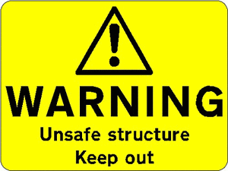
Claim Study #5
Discipline: Architect
Project: Renovation of an older building into a retail space
Services: Architectural design and construction observation services
Facts: Removal of a load bearing wall without additional support causing the building to collapse which led to the death of a contractor
Claimed Damages: Not looking good

Slide 14
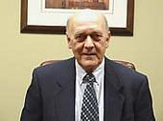
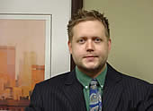
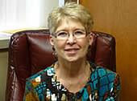
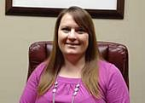
The Importance of Having Both
Professional Liability and General Liability Coverage
Ask PUI for Insurance Recommendations!

Slide 15
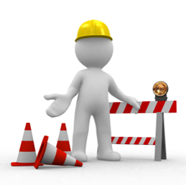
Conclusion
Bodily injury claims happen
Fight the claim when it makes sense
Even without clear liability, settlement may be the best choice
Utilize resources and peer review to prevent errors
Protect yourself contractually and carry insurance

Slide 16
Questions?
Roseanne DeBellis
Senior Claim Counsel
(203) 546-2082
rdebellis@navg.com
Allison Esrig
Vice President
(443)364-5940
aesrig@navg.com

