Slide 1

The pitfalls of Ai in construction
Or How I learned to love artificial intelligence
Scott D. Stoner, Deneweth, Vittiglio & Sassak, P.C.

Slide 2

What is artificial intelligence, or AI
This field of computer science centers on developing systems that can execute tasks generally associated with human intelligence, including reasoning, learning, decision-making, and problem-solving. Such systems are able to analyze large volumes of data, identify patterns, and modify their behavior autonomously over time without needing explicit programming.

Slide 3

What does ai rely upon to generate answers and solutions?
AI systems depend on pre-existing data to operate and drive innovation.
The algorithms behind AI are engineered to learn from and process extensive datasets, which may include textual, numerical, visual, or mixed data types.
This data forms the essential basis for AI’s capabilities, allowing it to produce precise predictions and valuable results. Without this foundational information, AI cannot function optimally.

Slide 4

How does ai impact the construction industry, namely architects and engineers?
..
AI possesses the potential to enhance the accuracy and outcomes of construction forecasts.
Conversely, AI can also lead to project designs that are unsuitable, overly costly, and misaligned with the project owner's vision.

Slide 5

THE POSITIVE IMPACT OF AI ON DESIGN AND CONSTRUCTION
• Generative Design
  Ability to create and evaluate many design options based on constraints such as cost, materials, lighting, and structural safety
• BIM
Integrated into Revit to analyze 3D building models.
• Structural Analysis
• Energy Efficiency & Sustainability
Analyze environmental factors like sunlight, temperature, and airflow to design more energy-efficient buildings.
• Site Layout and Construction Planning
The optimization of how a construction site is organized.
• Risk Predictions During Design
Analyze past construction data to identify risks prior to construction.

Slide 6
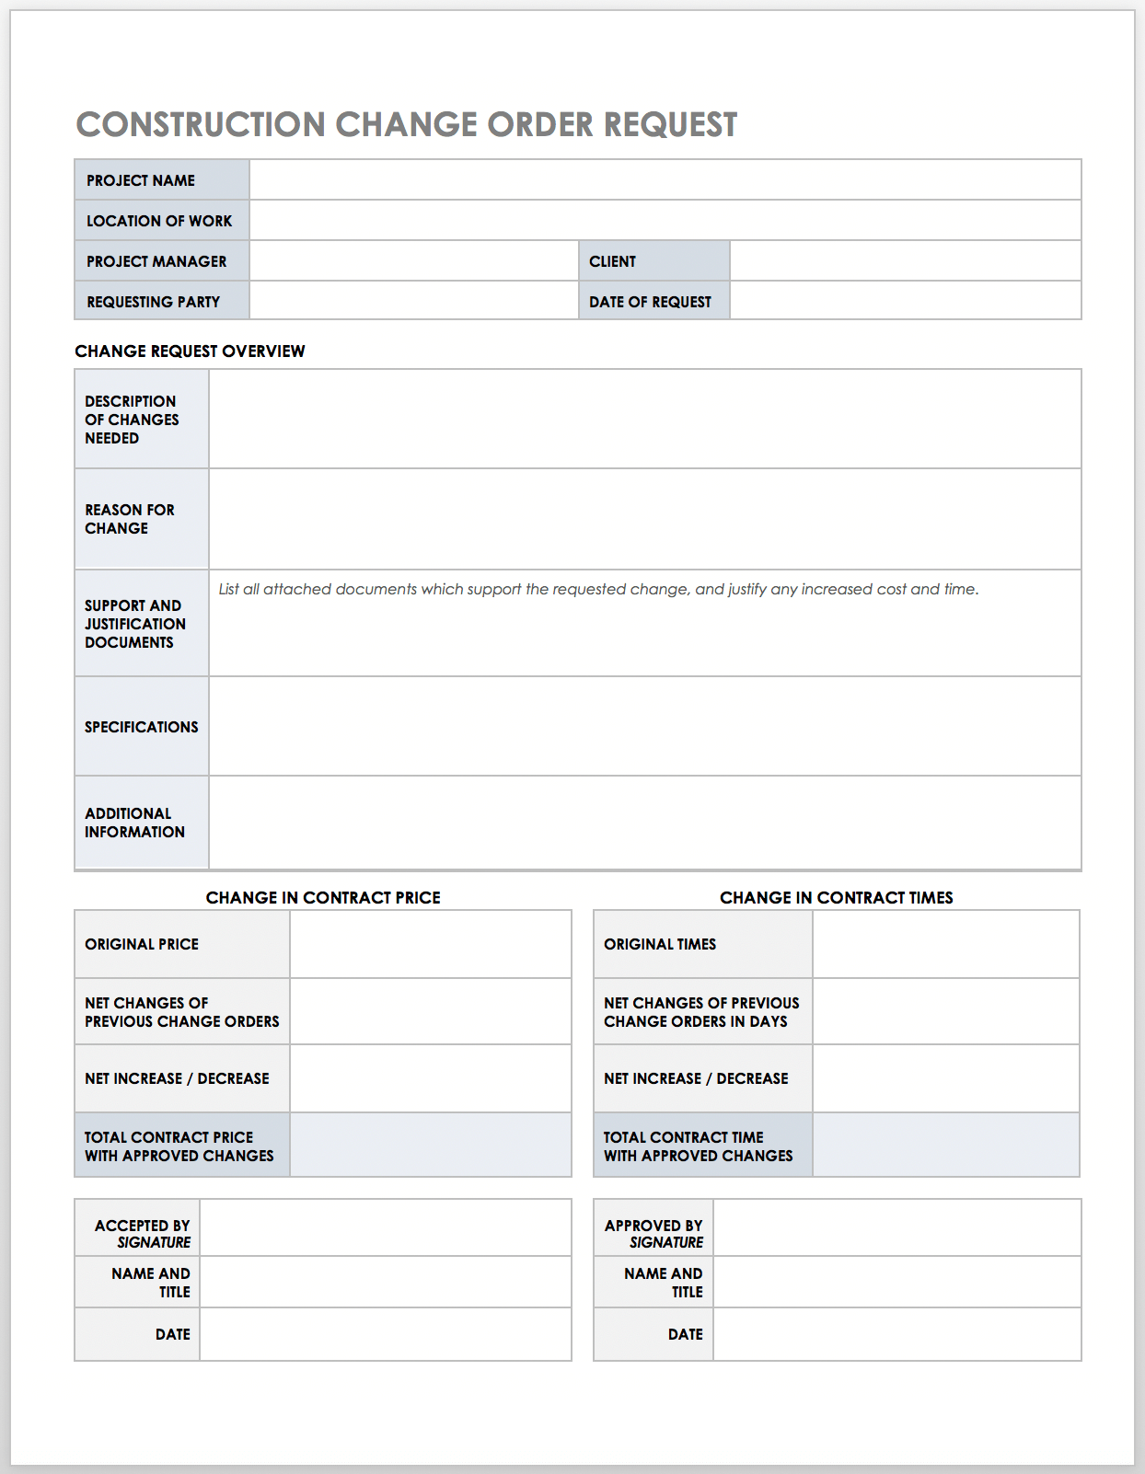
The downside of using ai
Poor or Incomplete Data
Over-Reliance on AI
Lack of Transparency (Black Box Problem)
Integration Problems with Existing Systems
High Implementation Costs
Bias in Design Recommendations
Regulatory and Code Compliance Issues
Cybersecurity and Data Privacy Risks
Liability and Legal Responsibility

Slide 7
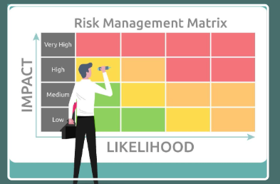
FOR YOUR CONSIDERATION AND THE MANAGEMENT OF AI RISKS
Staffing the Project
Coordination with other disciplines
You will need everyone to use the same programs
Internal peer review. External peer review
Contractor must be involved

Slide 8
Building a better contract: can you draft a better contract to manage risk?
If the owner wants AI to be used, incorporate disclaimers in the contract regarding the limitations of AI
Owner’s assumption of the risk
Standard of Care provision on AI use
Explain limitations in contract of using AI

Slide 9

Summary of ai use for designers
Effectively leveraging AI requires more than simply pressing a button for instant success.
Resource allocation should be managed at the contract stage and incorporated into the peer review process.
It is essential that the entire design team maintains alignment throughout the review.
Utilizing AI does not exempt designers from upholding the established standard of care.
Scott D. Stoner
sstoner@dvs-law.com
248-290-0480

