Slide 1
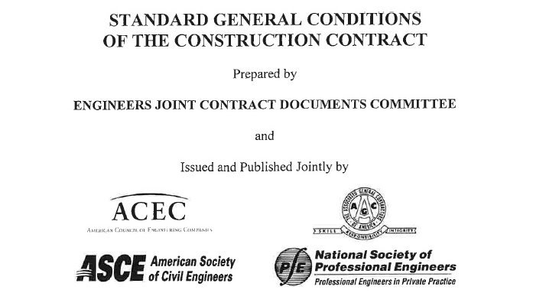
EJCDC:
Terms, Conditions and Consequences
Thomas F. Waggoner
Straub, Seaman & Allen, P.C.
twaggoner@lawssa.com
(269) 982-7715

Slide 2

First Exercise – Fully Integrated & Mutual Drafting

Slide 3
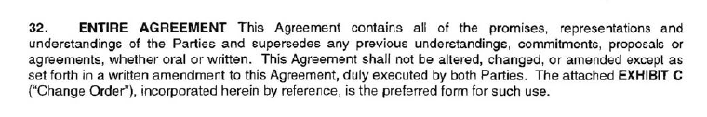

Design Engineering Services Agreement

Slide 4
Second Exercise – Scope of Services?

Slide 5
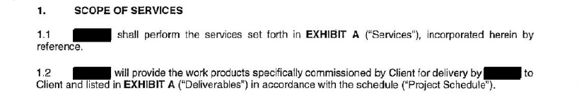

Design Engineering Services Contract*

Slide 6
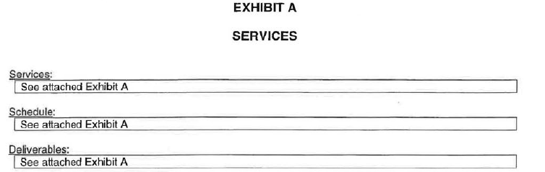
Design Engineering Services Agreement

Slide 7
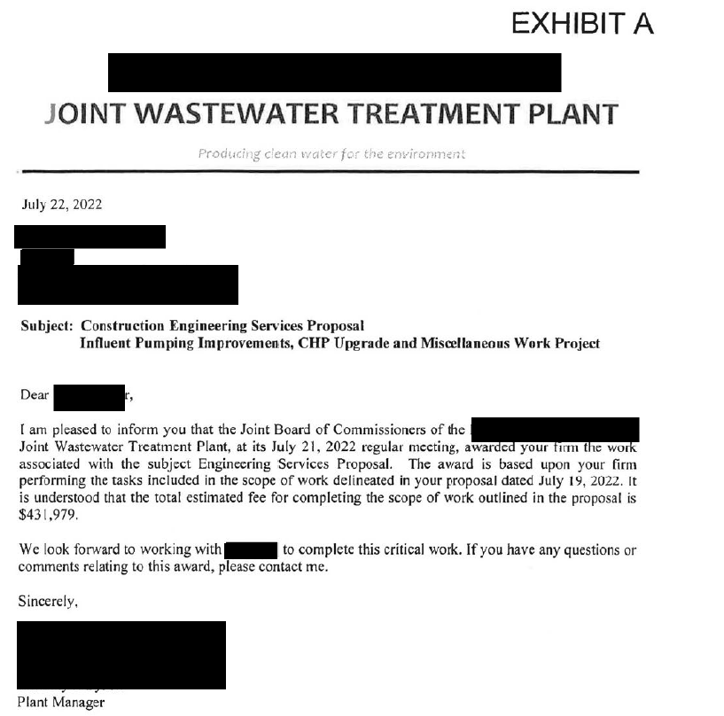

Design Engineering Services Agreement

Slide 8
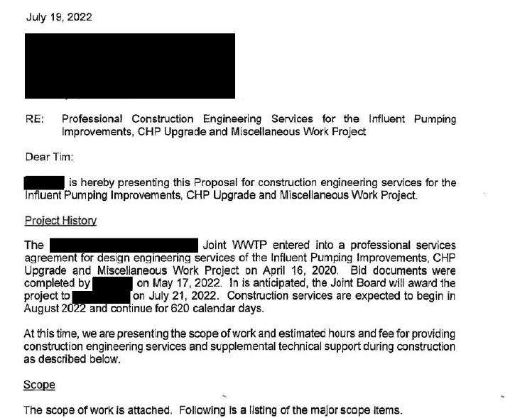

Design Engineering Services Agreement

Slide 9

Design Engineering Services Agreement
Design Engineering Services Agreement

Slide 10
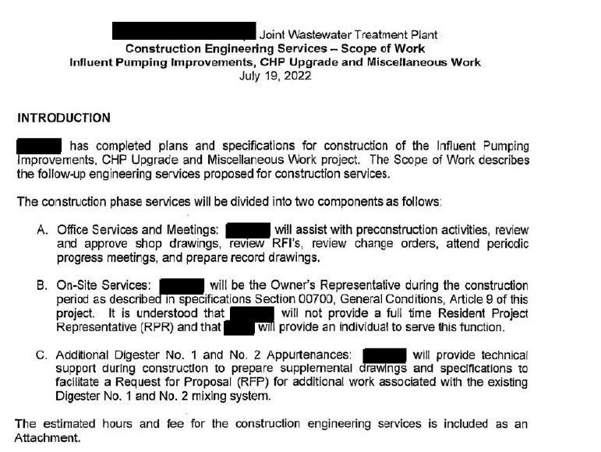
Design Engineering Services Agreement

Slide 11
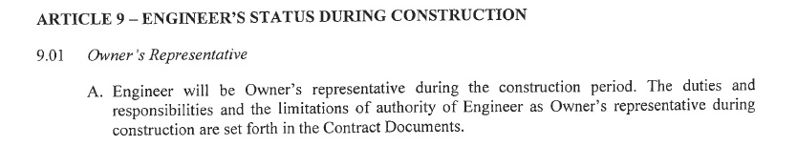
EJCDC C-700 Standard General Conditions of Construction Contract

Slide 12

Supplementary Conditions

Slide 13
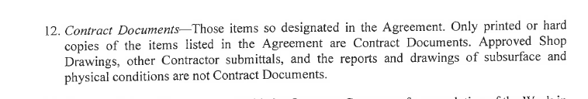
EJCDC C-700 General Conditions

Slide 14
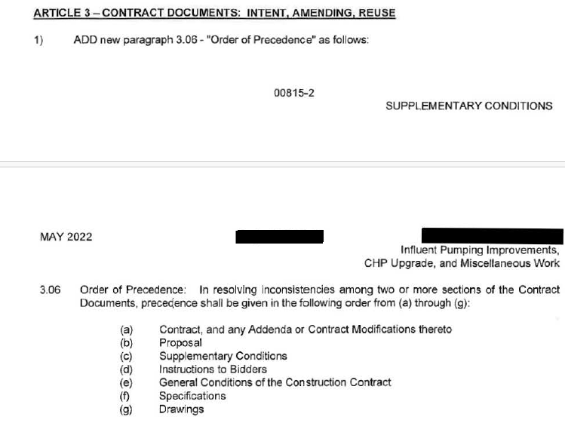
Supplementary Conditions

Slide 15
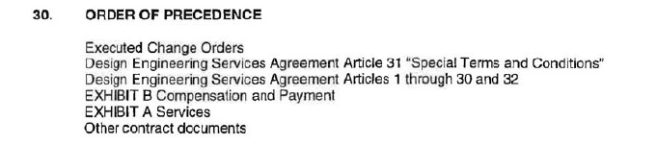
Design Engineering Services Agreement

Slide 16
Design Engineering Services Agreement

Slide 17
Third Exercise – Scope of Services Part II

Slide 18
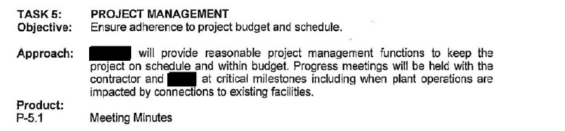

Design Engineering Services Agreement
Design Engineering Services Agreement
EJCDC C-700 General Conditions
?

Slide 19
Webster’s Ninth New Collegiate Dictionary
Ensure: To make sure, certain, or safe: GUARANTEE

Slide 20
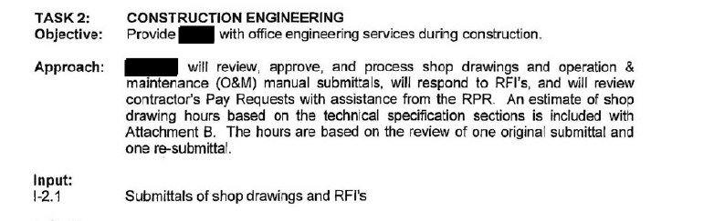

Design Engineering Services Agreement
Design Engineering Services Agreement
EJCDC C-700 General Conditions
?

Slide 21
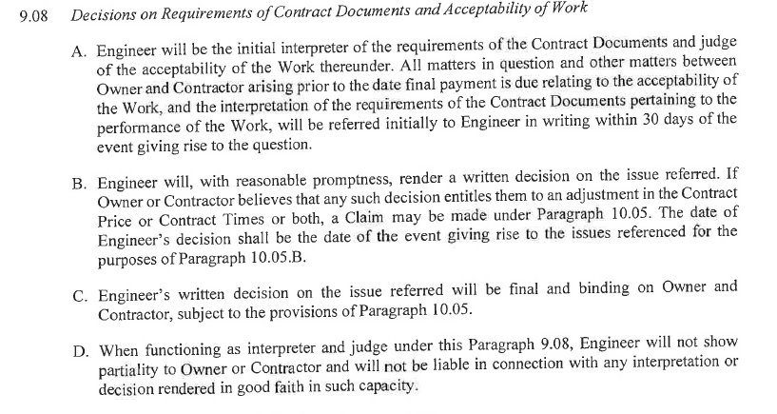


EJCDC C-700 General Conditions

Slide 22
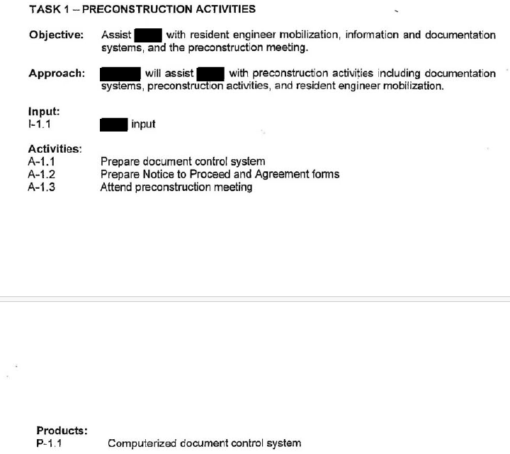

Design Engineering Services Agreement
Design Engineering Services Agreement
EJCDC C-700 General Conditions
?

Slide 23
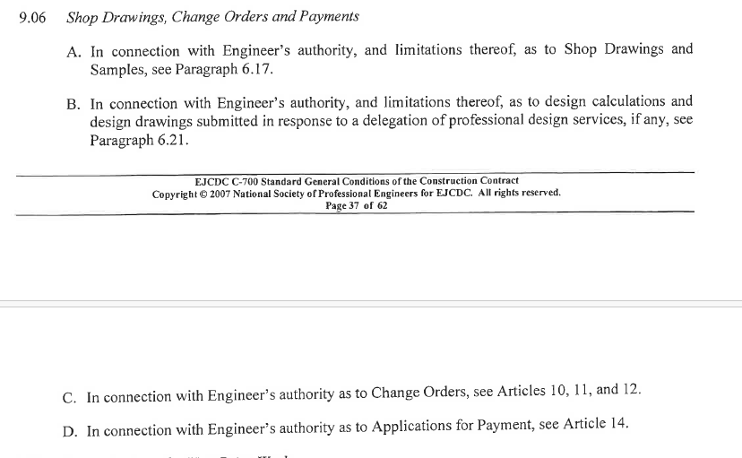
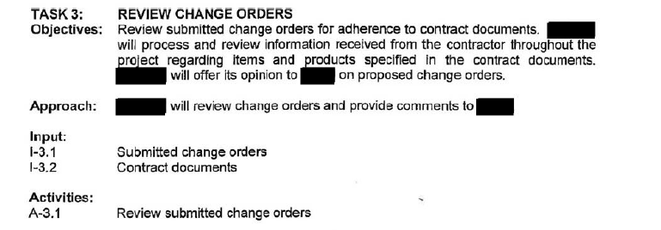

Design Engineering Services Agreement
Design Engineering Services Agreement
EJCDC C-700 General Conditions
?

Slide 24
Fourth Exercise – Resident Project Representative

Slide 25
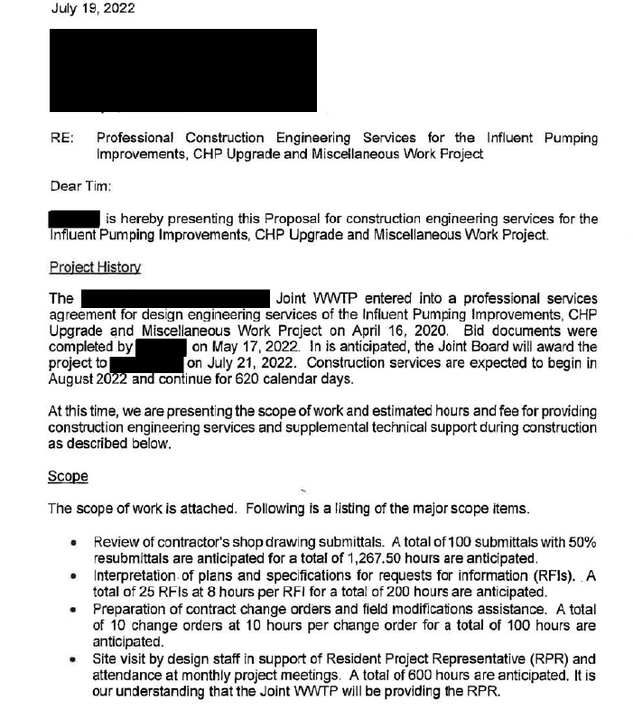

Design Engineering Services Agreement

Slide 26

Supplementary Conditions

Slide 27
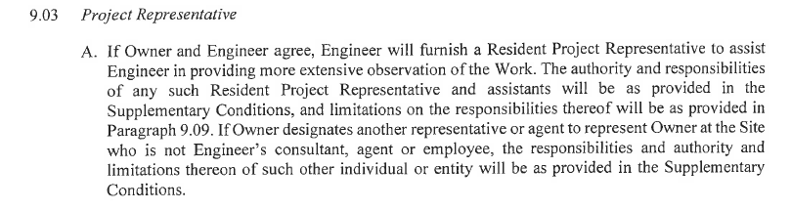






EJCDC C-700 General Conditions

Slide 28
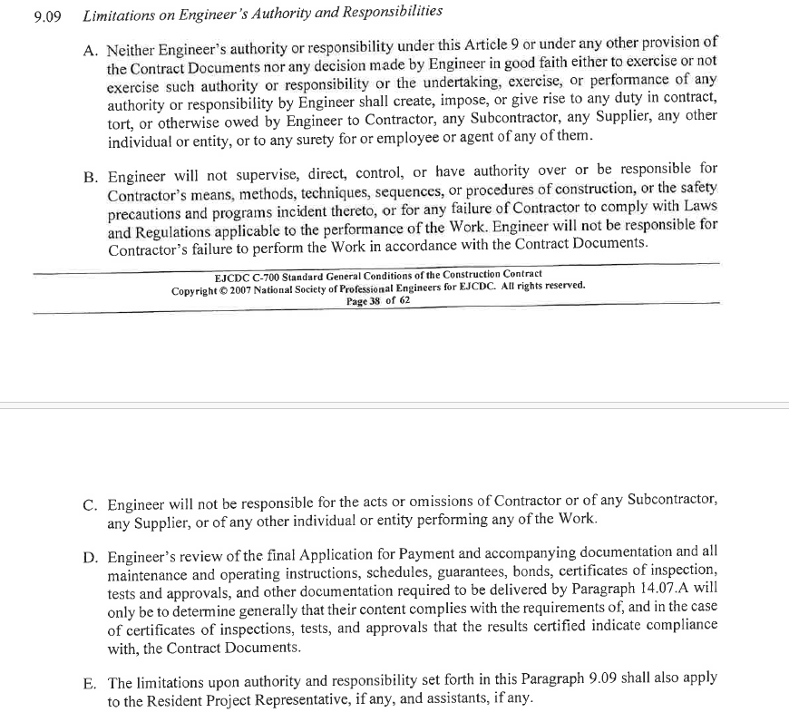


EJCDC C-700 General Conditions of the Construction Contract
??

Slide 29
Fifth Exercise – Impartial Interpreter

Slide 30




EJCDC C-700 General Conditions

Slide 31
SixthExercise – Changes in the Work; Claims

Slide 32
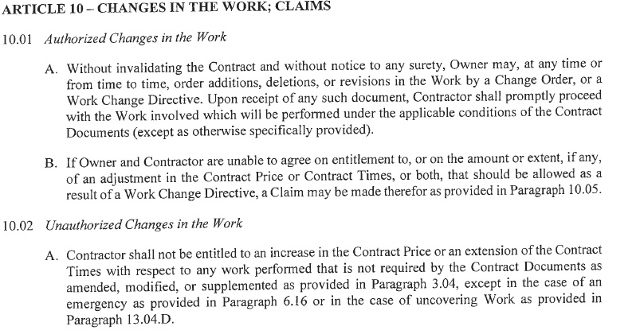


EJCDC C-700 General Conditions

Slide 33
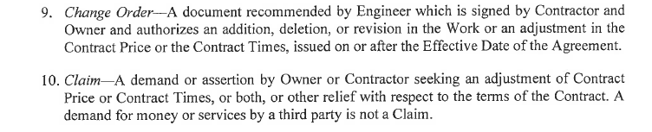
EJCDC C-700 General Conditions

Slide 34
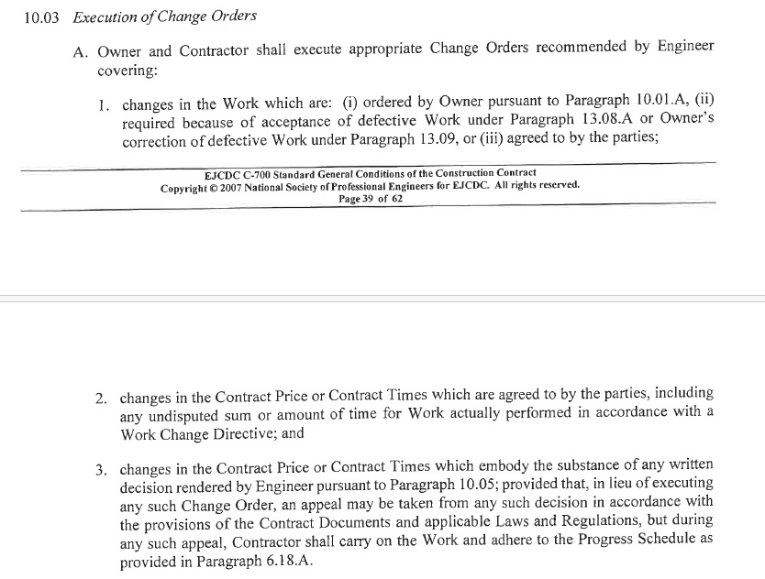
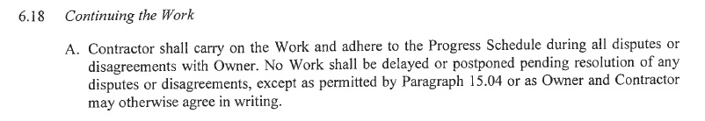



EJCDC C-700 General Conditions

Slide 35
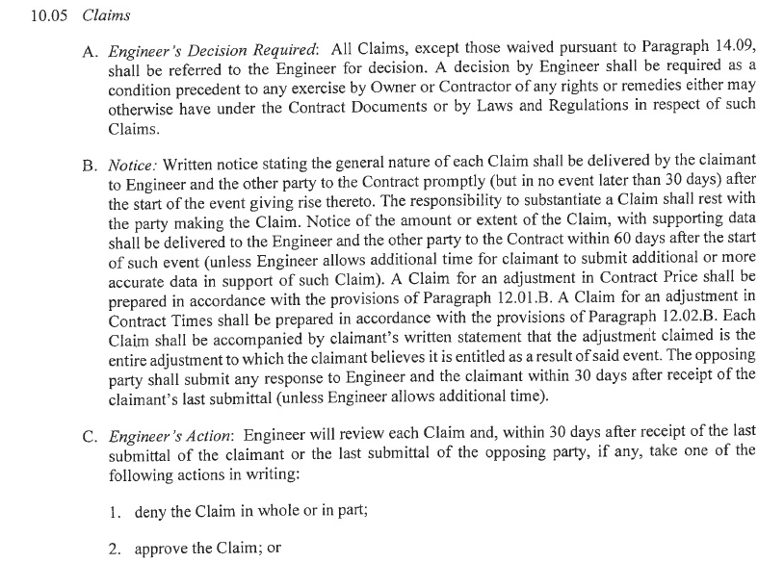
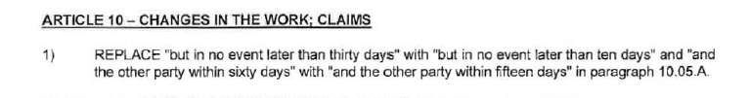
EJCDC C-700 General Conditions

Slide 36
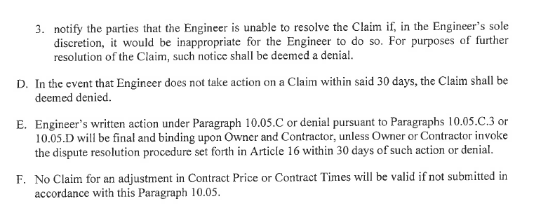
EJCDC C-700 General Conditions

Slide 37
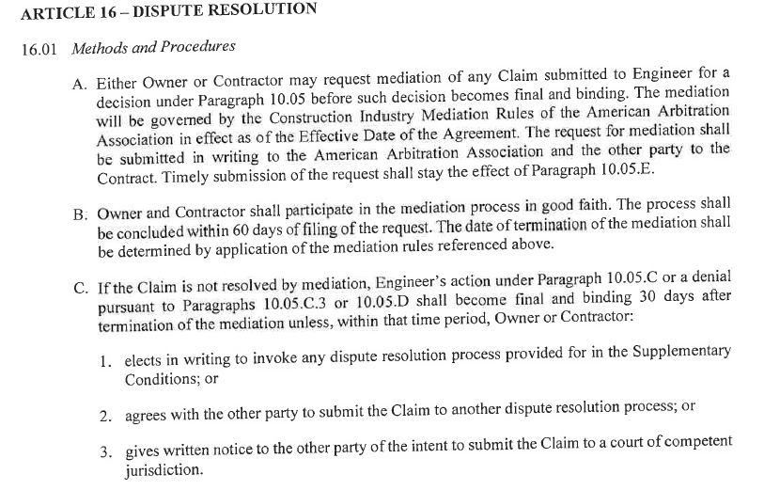
EJCDC C-700 General Conditions

Slide 38
Sixth Exercise – Liquidated Damages

Slide 39
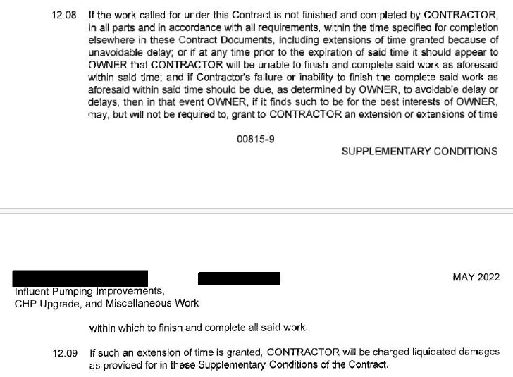
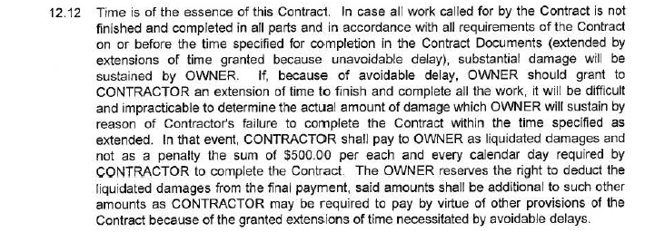







Supplementary Conditions

